Slide 1


Progress Pictures
Construction of Commercial & Cineplex
I-8 Markaz, Islamabad
April – December
2020

Slide 2
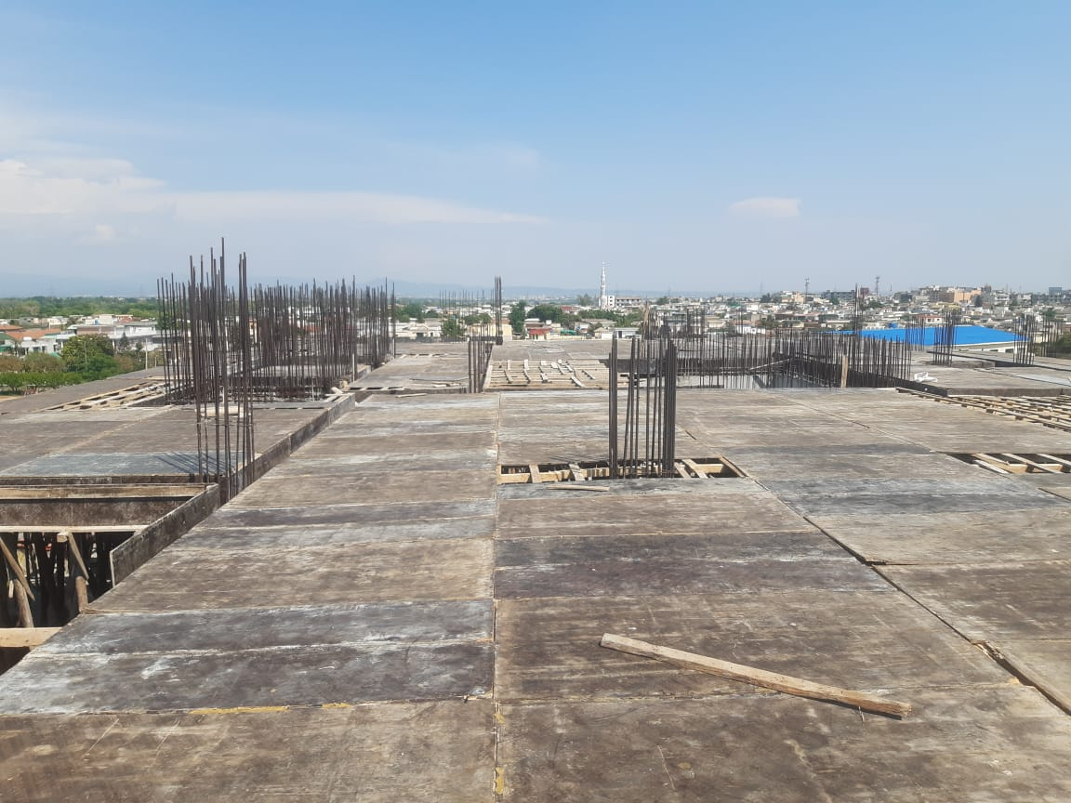
FDOC-Formwork For Roof Slab (April 2020)

Slide 3
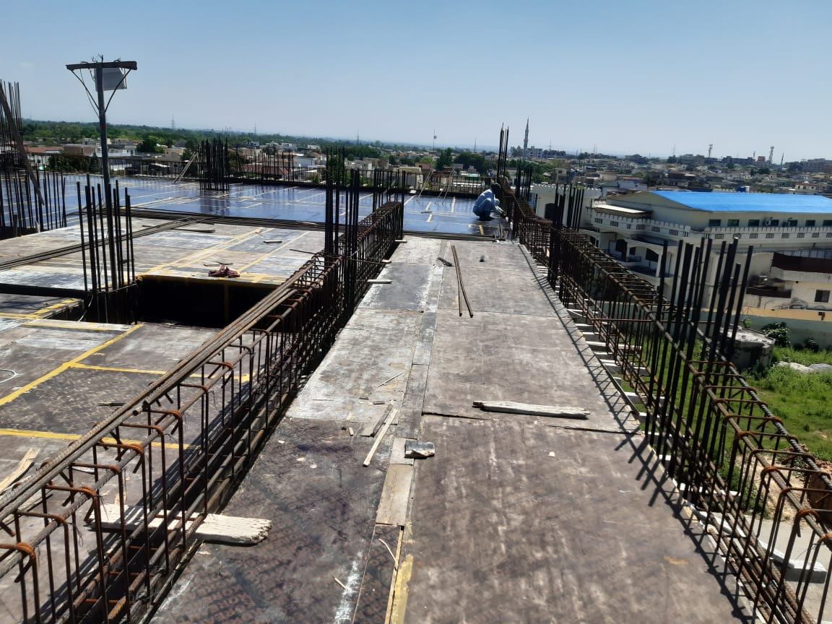
FDOC-Rebar Work at Roof Slab (April 2020)

Slide 4
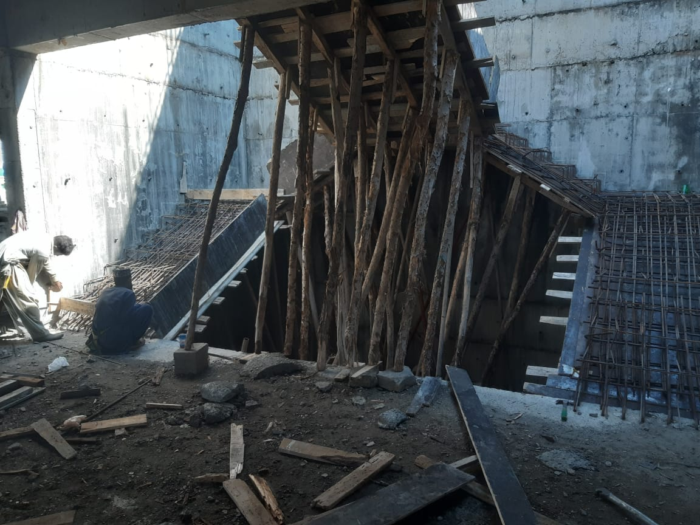
FDOC-Rebar & Formwork at Main Stairs (April 2020)

Slide 5
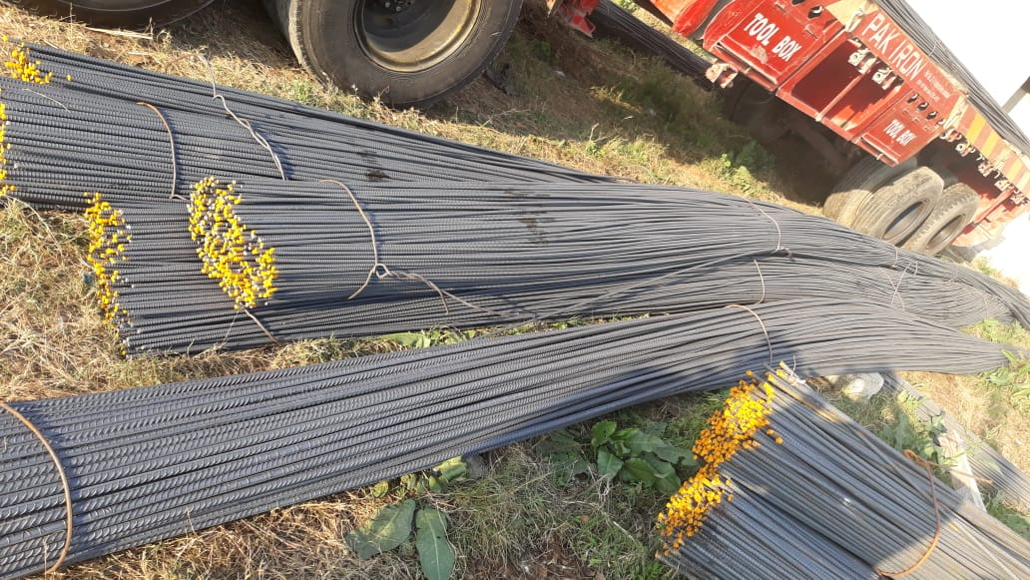
FDOC-Supply of Steel by Pak Iron (April 2020)

Slide 6
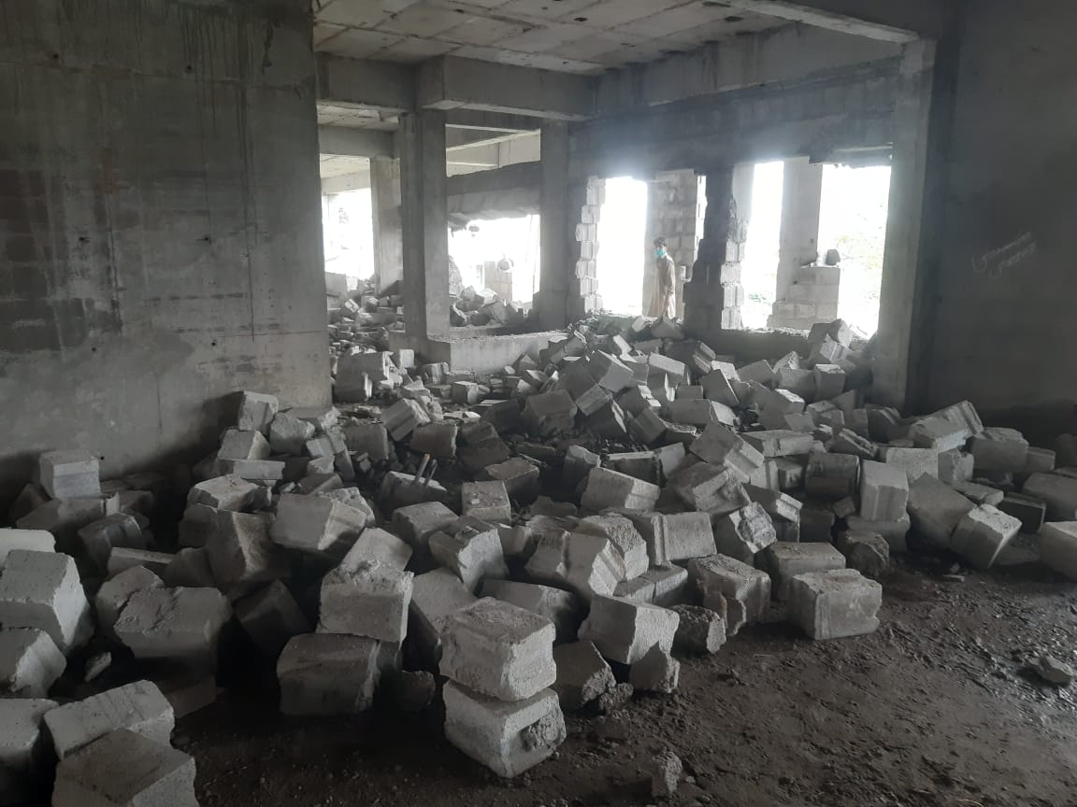
FDOC-Dismantling of Block Masonry (April 2020)

Slide 7
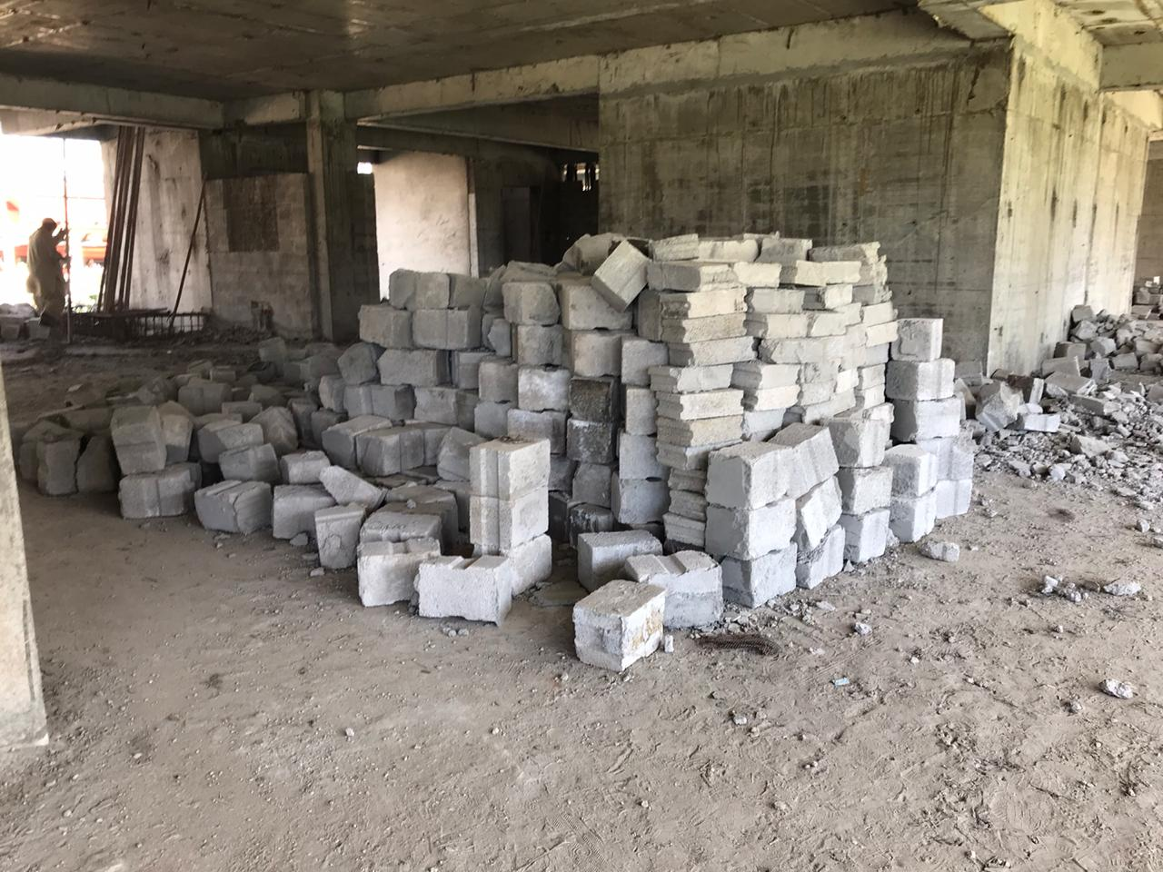
FDOC-Dismantling of Block Masonry (April 2020)

Slide 8
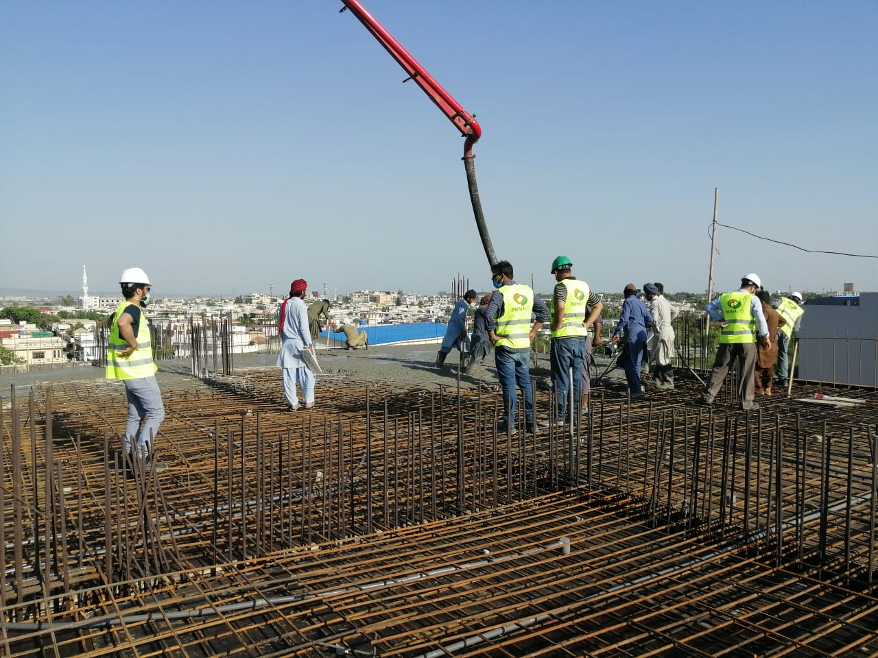
FDOC - Concrete Placement of Roof Slab (May 2020)

Slide 9
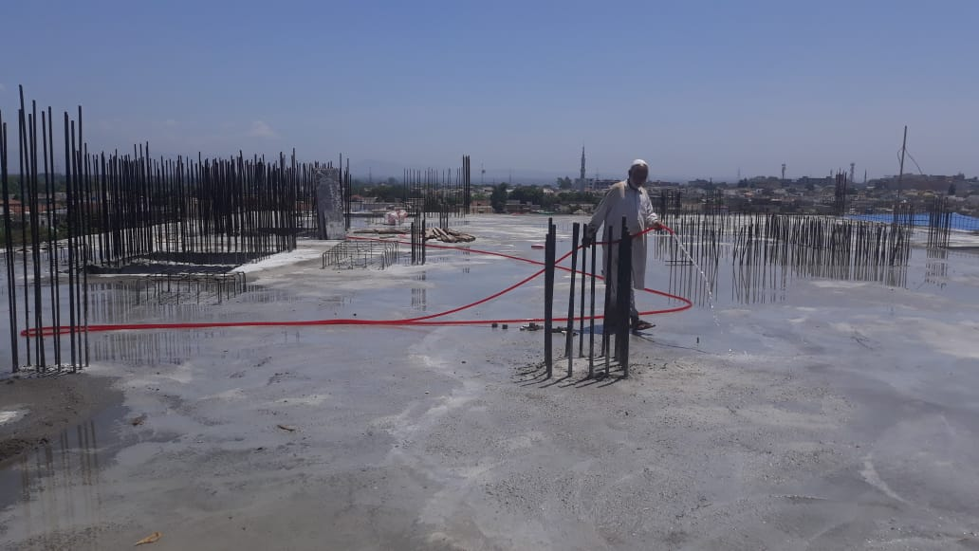
FDOC - Concrete Placement of Roof Slab (May 2020)

Slide 10
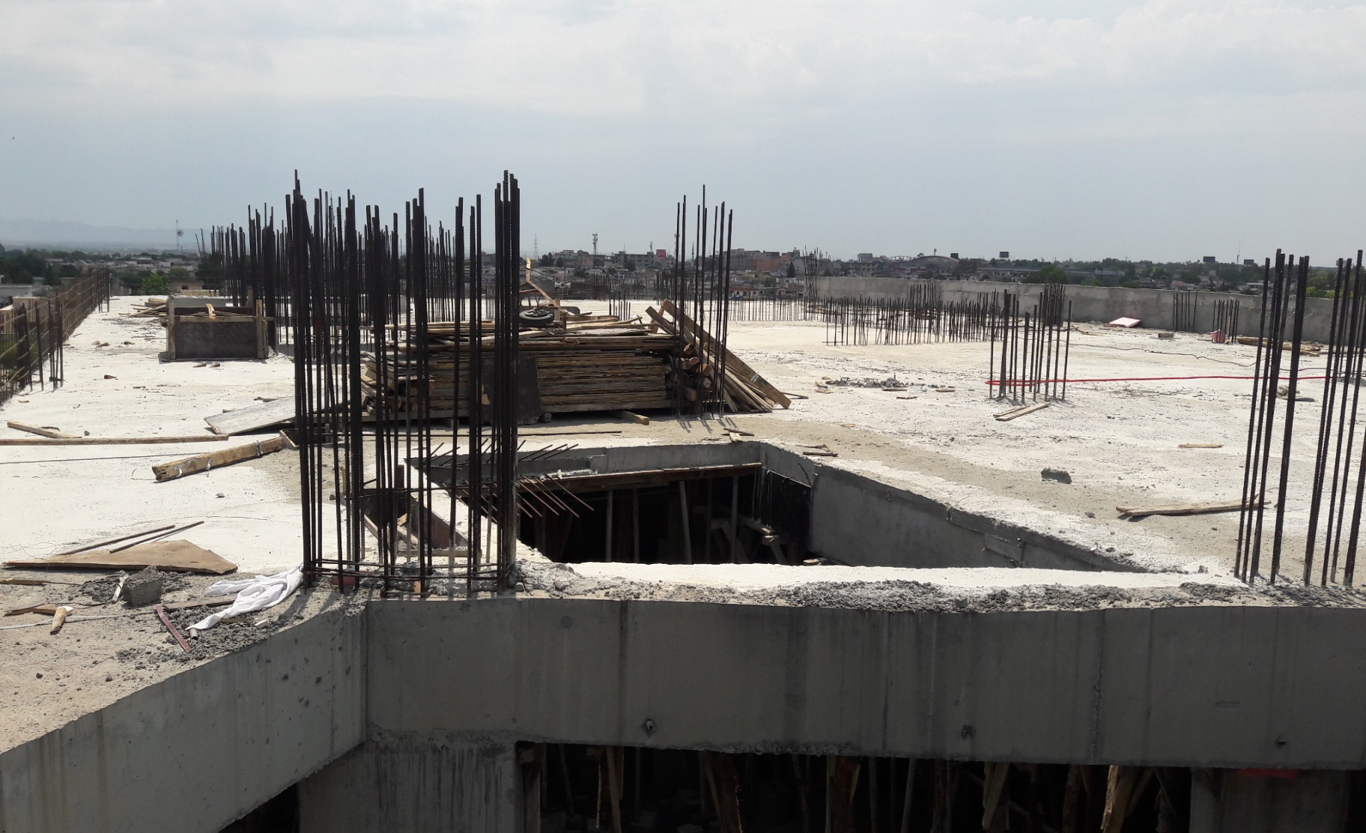
FDOC - Roof Slab & Parapet Wall (May 2020)

Slide 11
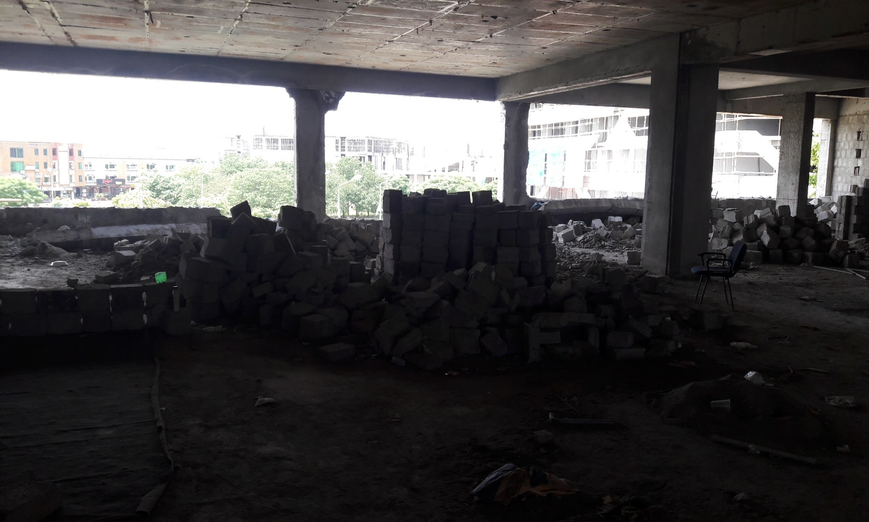
FDOC - Dismantling of Block Masonry (May 2020)

Slide 12
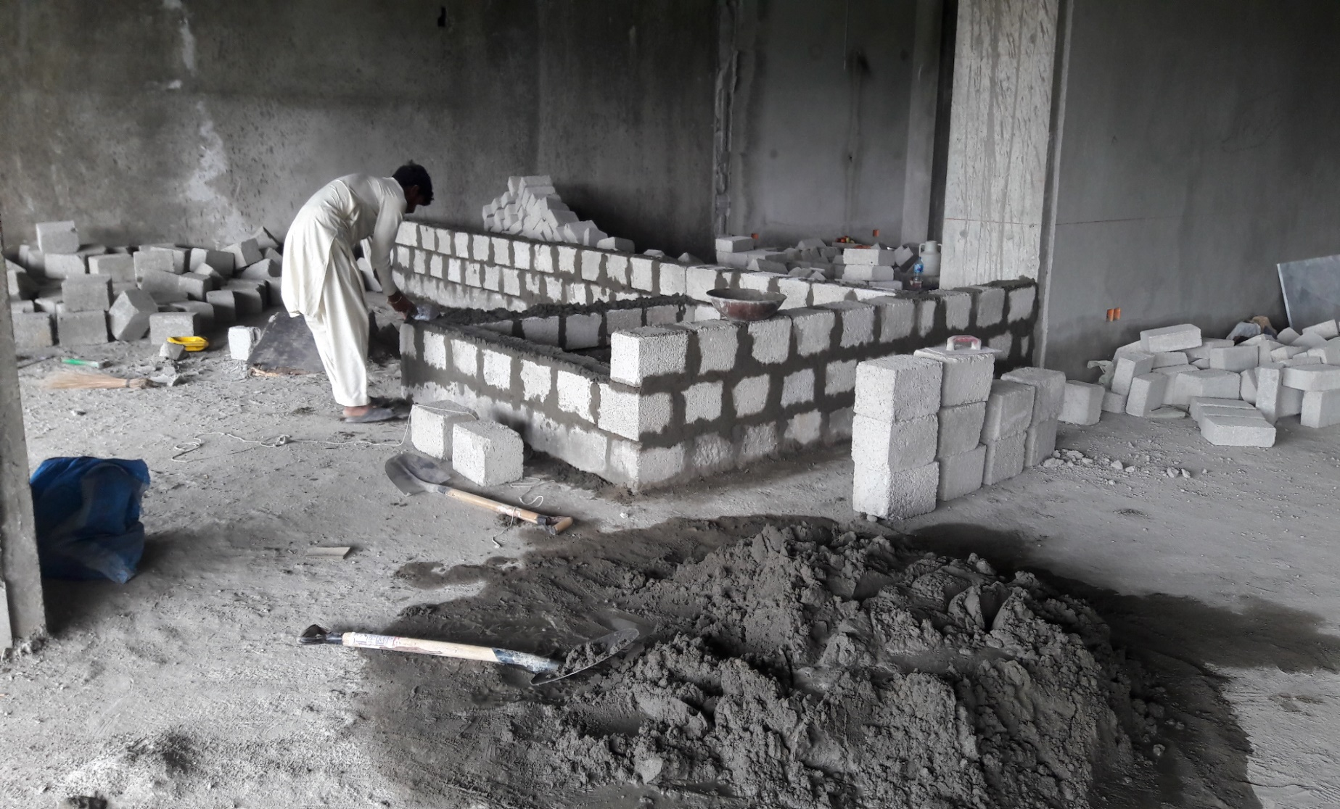
FDOC - Block Masonry (May 2020)

Slide 13
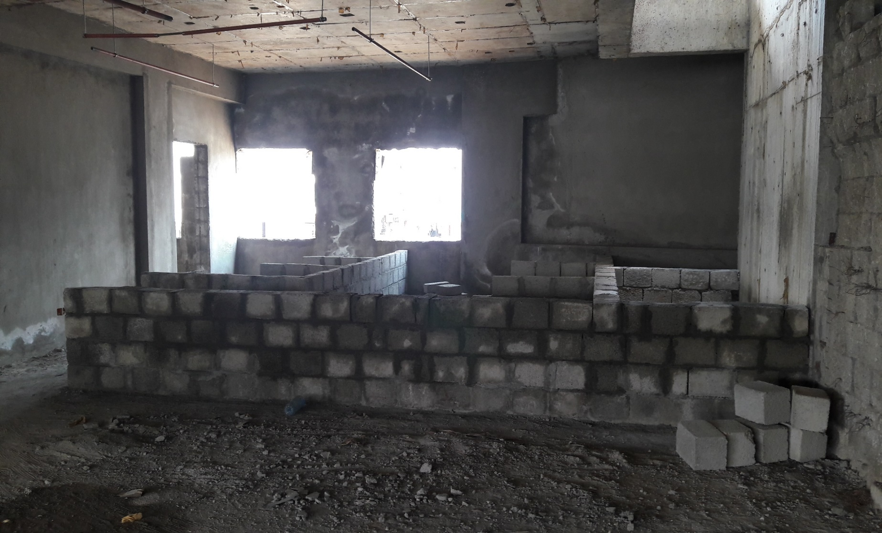
FDOC - Block Masonry (May 2020)

Slide 14
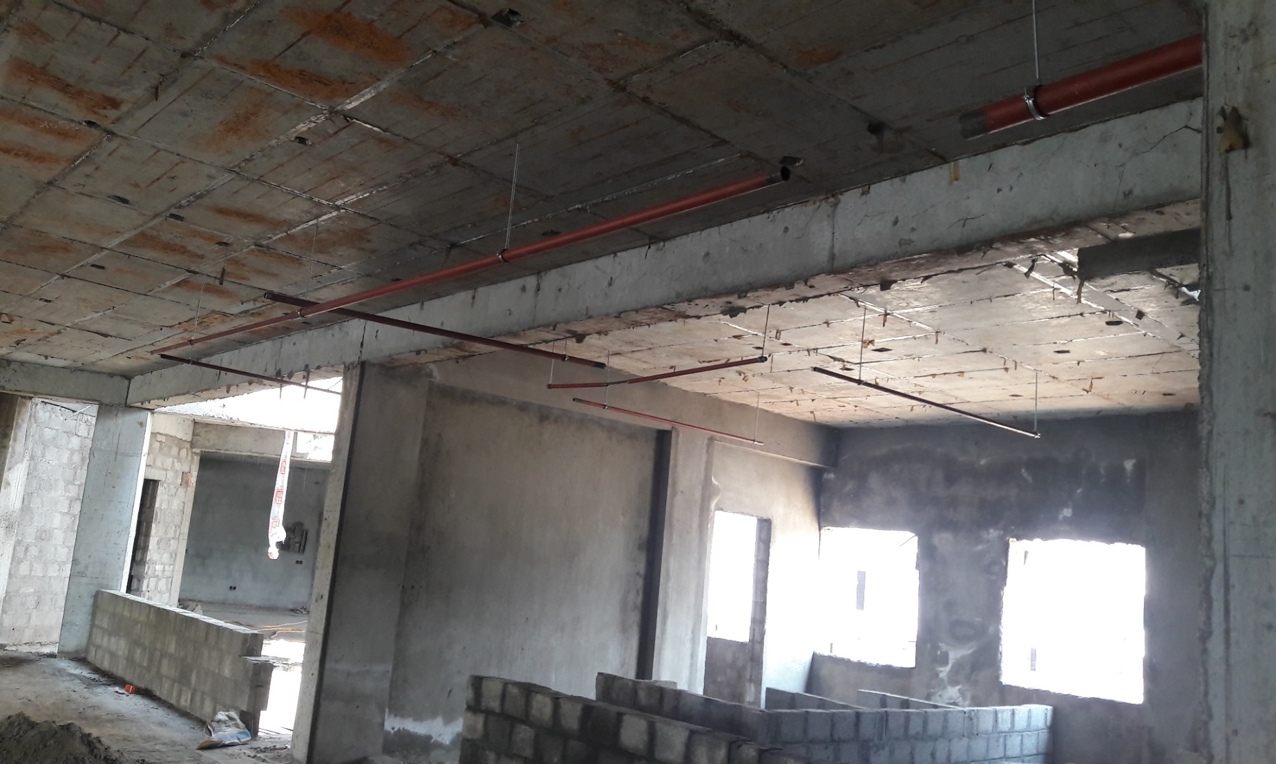
FDOC – Erection of Fire Fighting Pipes (May 2020)

Slide 15
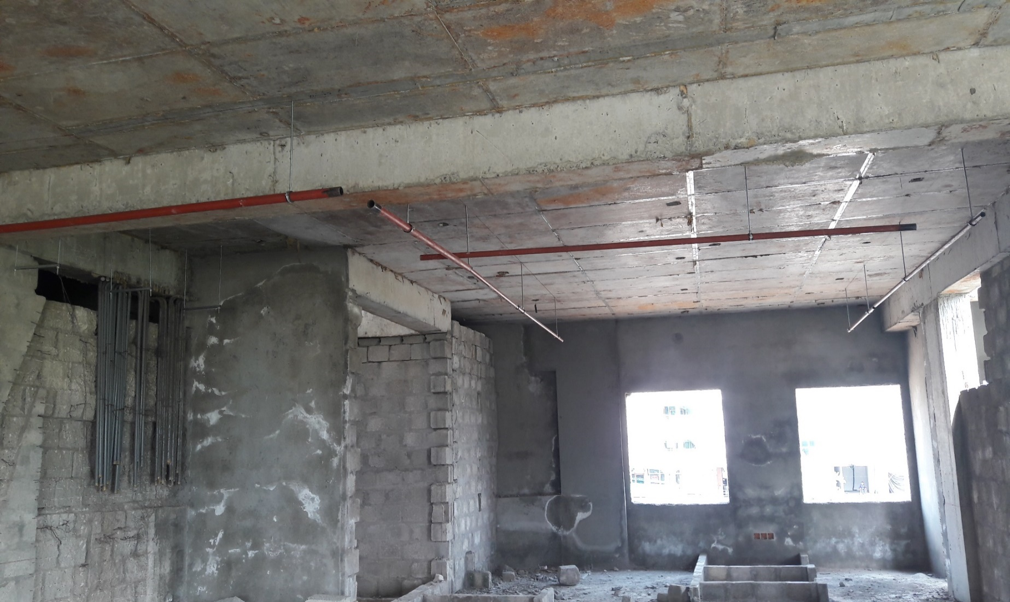
FDOC – Erection of Fire Fighting Pipes (May 2020)

Slide 16
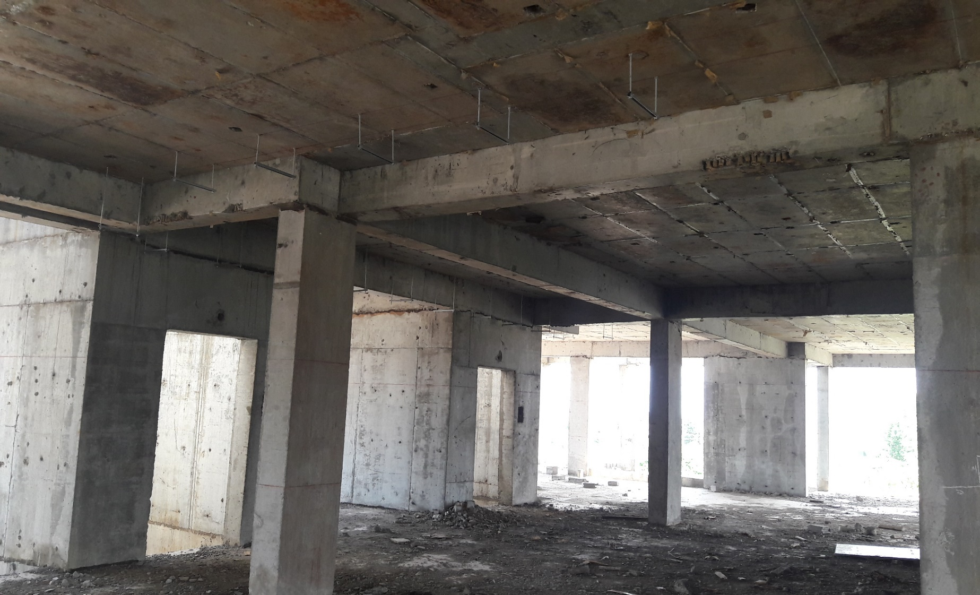
FDOC – Erection of Supports for Cable Tray (May 2020)

Slide 17
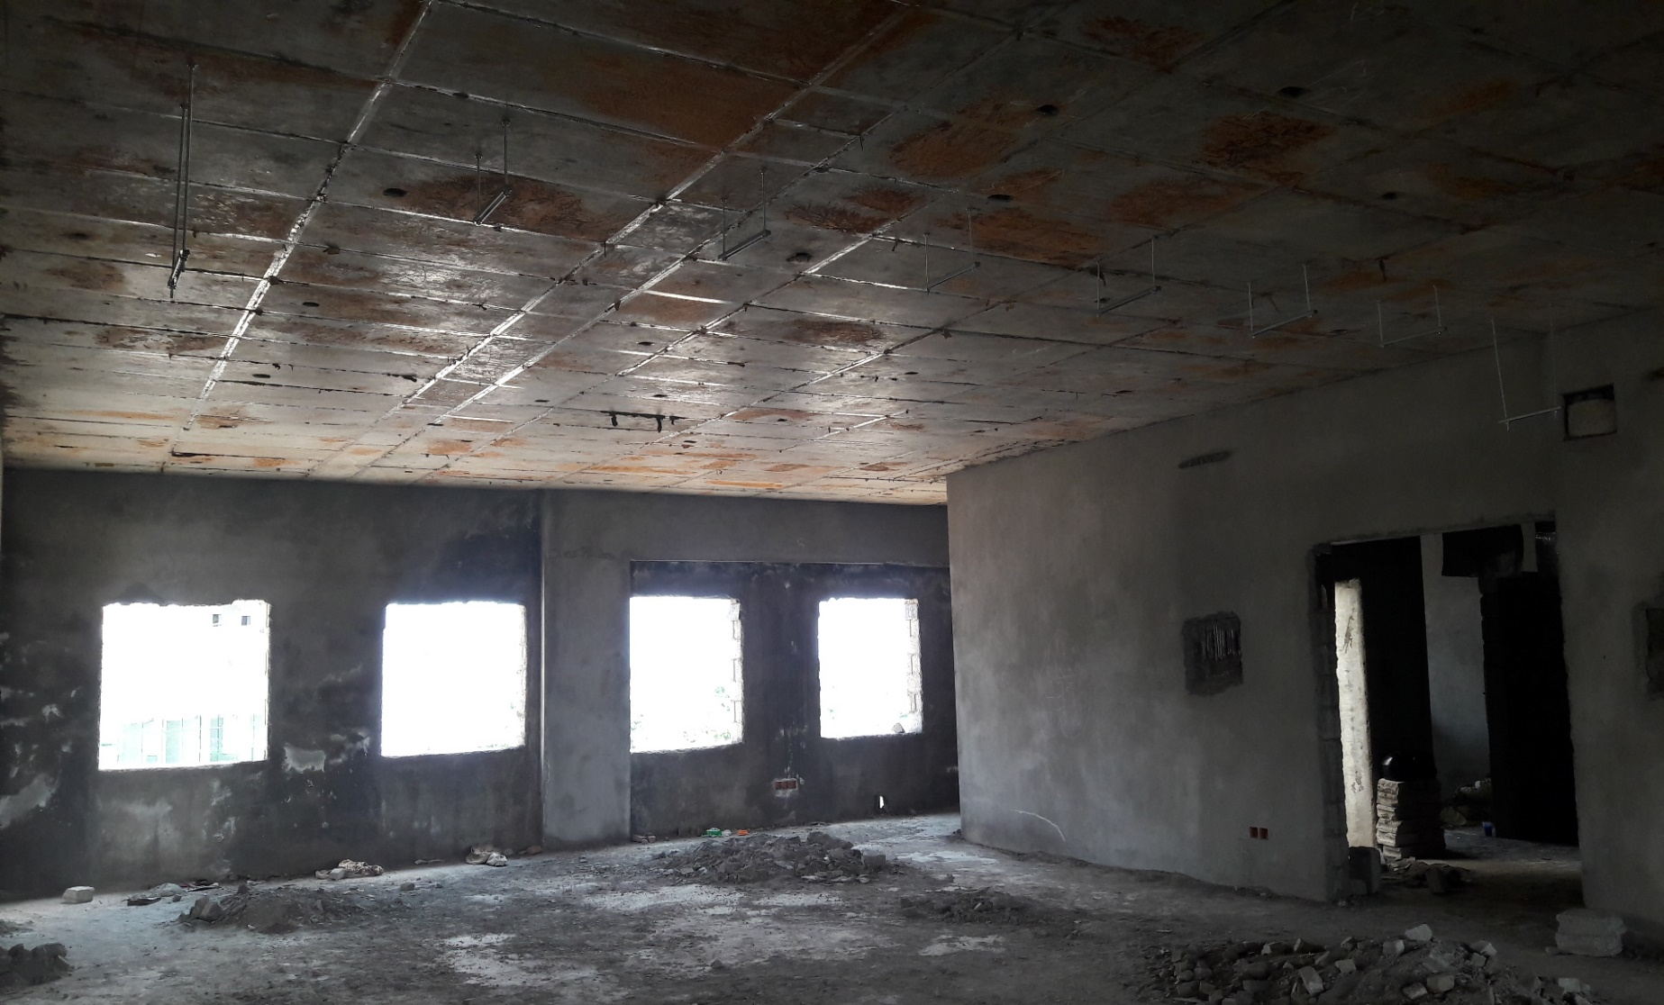
FDOC – Erection of Supports for Cable Tray (May 2020)

Slide 18
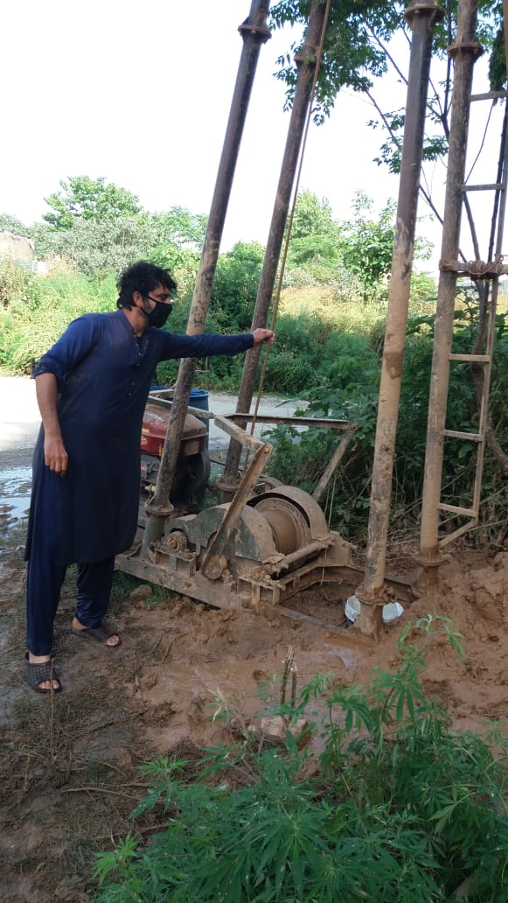
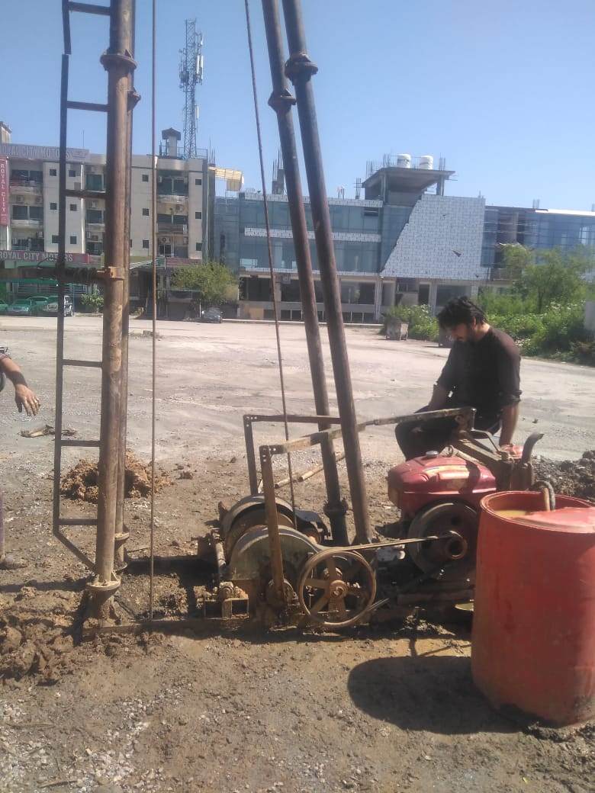
FDOC – Bore Hole for Earthing (May 2020)

Slide 19
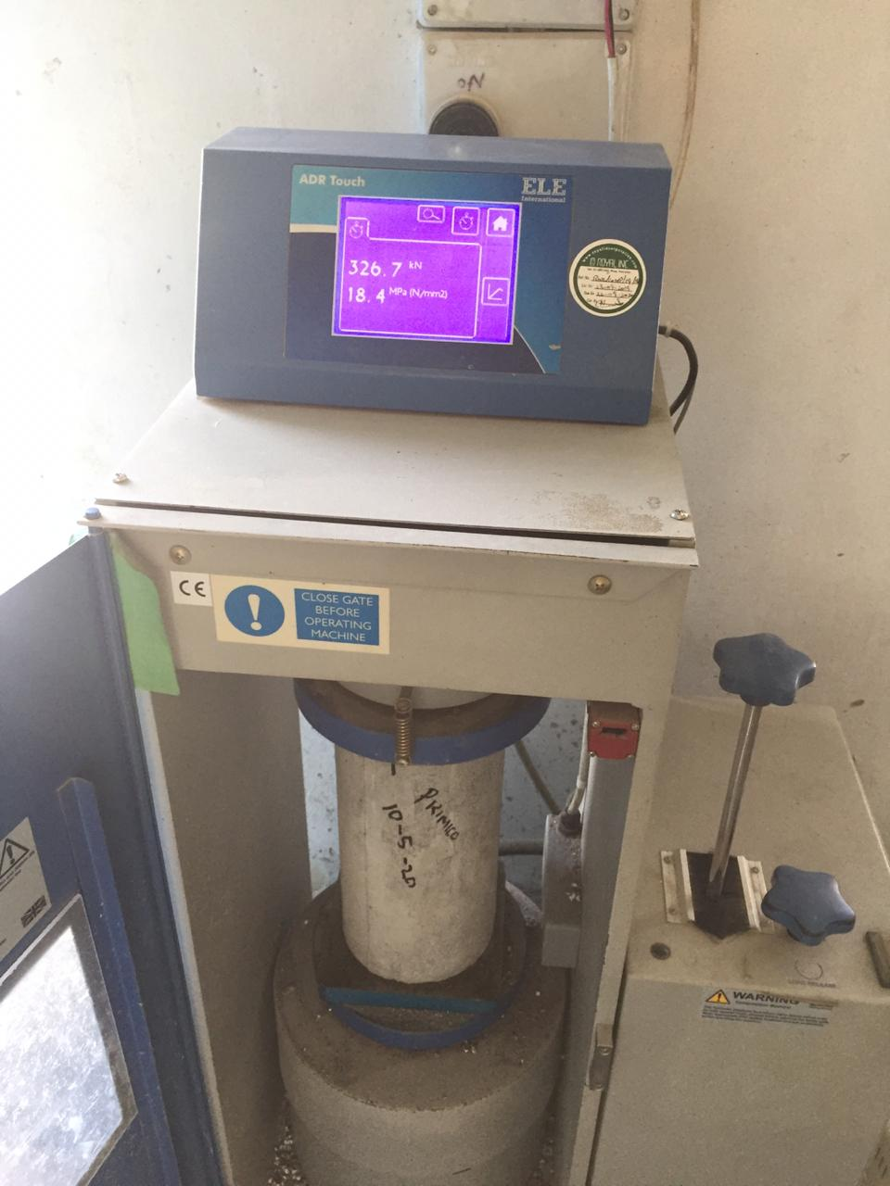
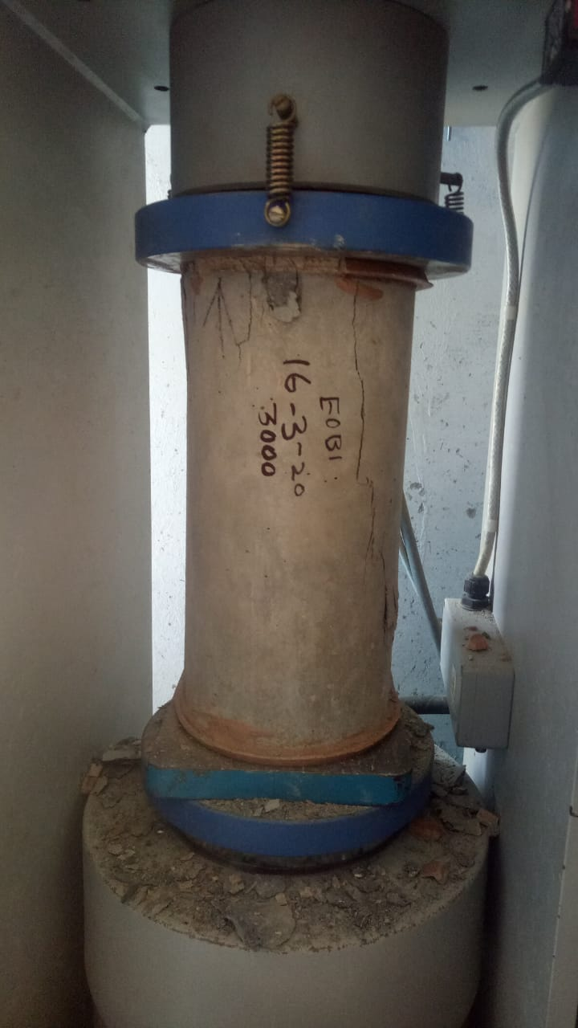
FDOC – Concrete Strength Testing (May 2020)

Slide 20
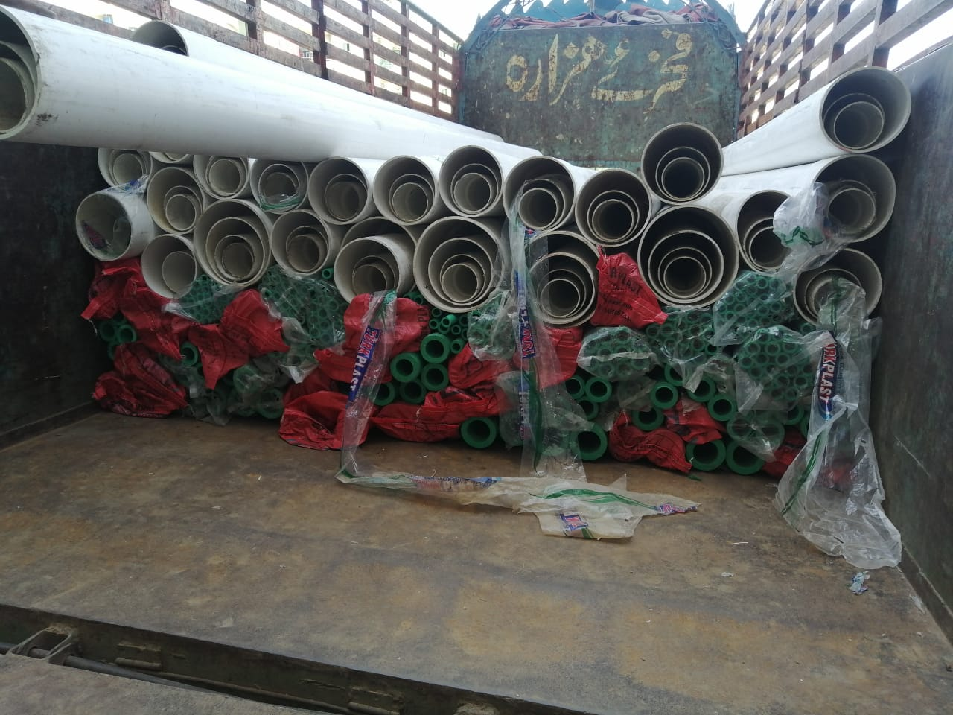
FDOC – Supply of Pipes (May 2020)

Slide 21
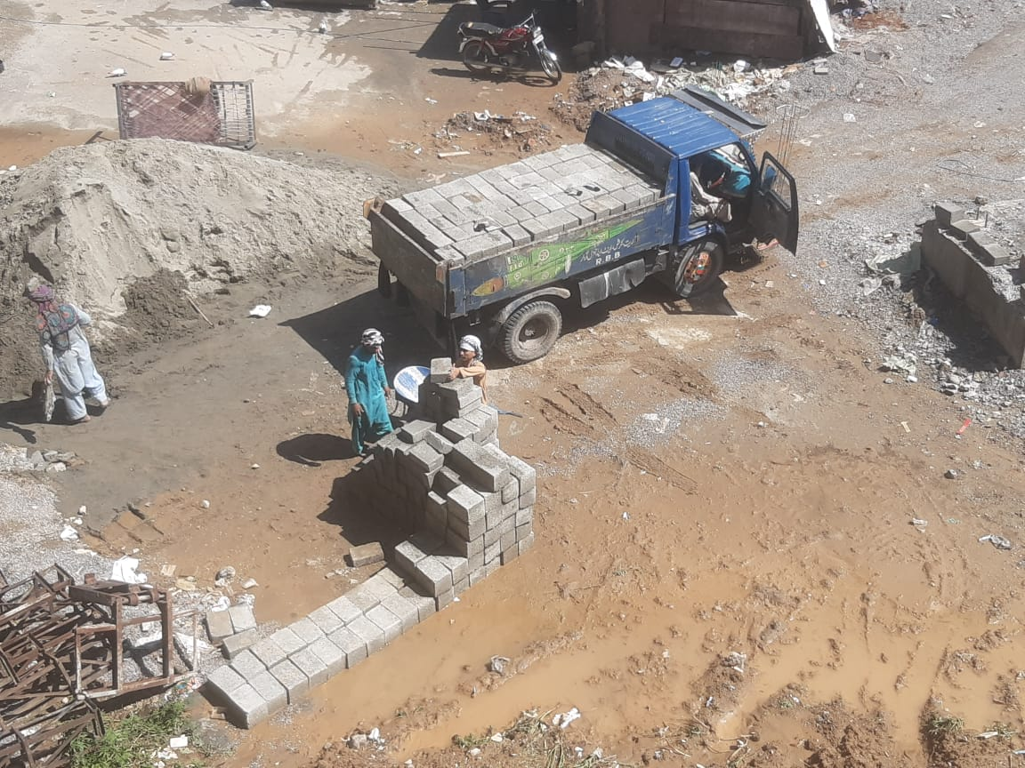
FDOC – Supply of Concrete Blocks (May 2020)

Slide 22
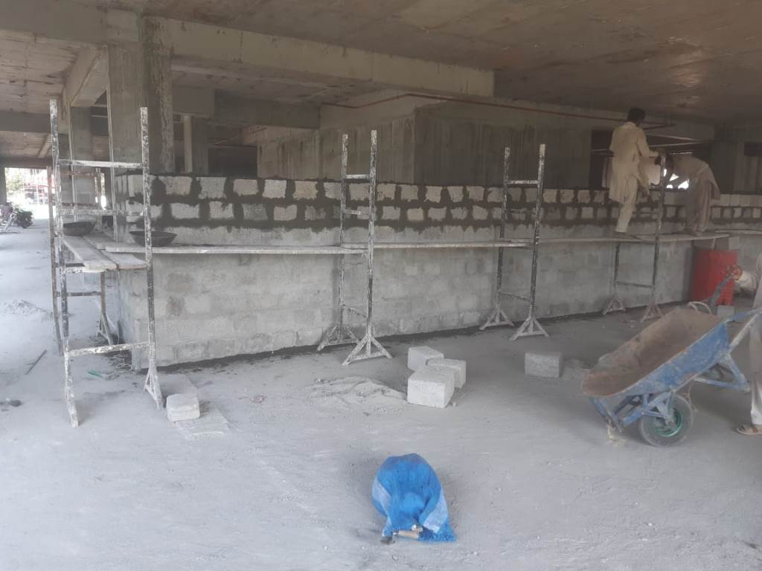
FDOC - Block Masonry (June 2020)

Slide 23
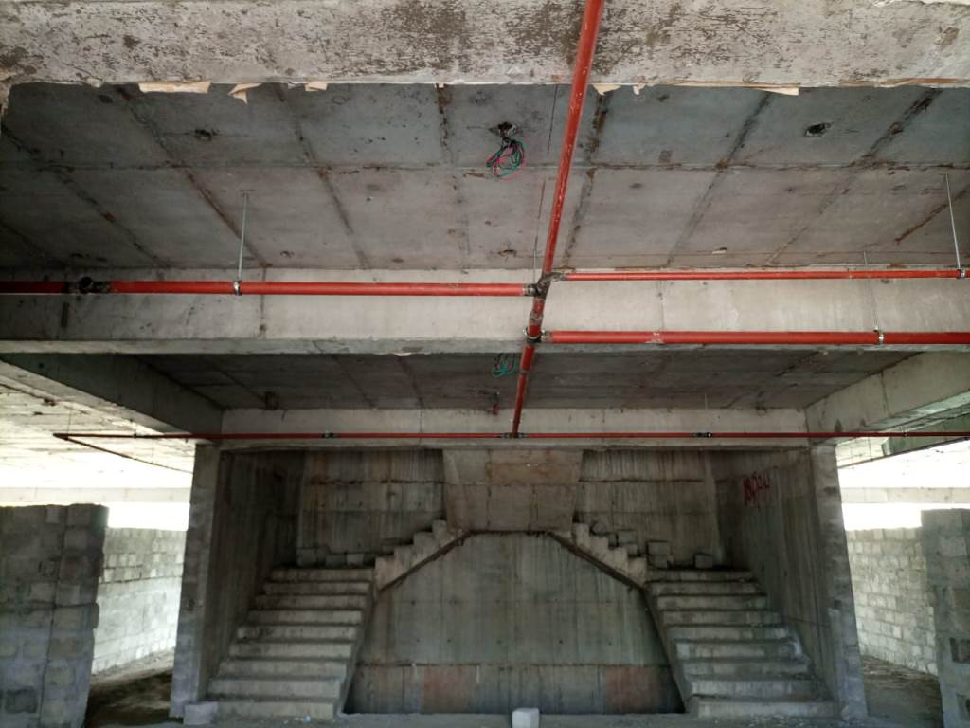
FDOC – Erection of Fire Fighting Pipes (June 2020)

Slide 24
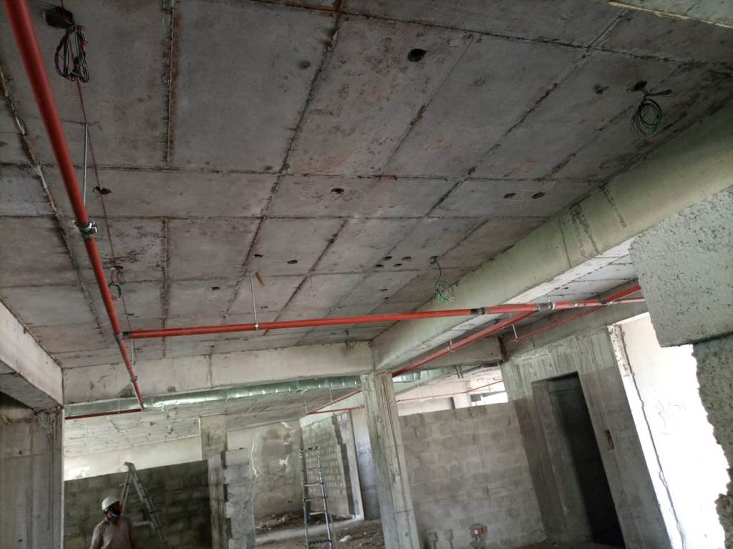
FDOC – Erection of Fire Fighting Pipes (June 2020)

Slide 25
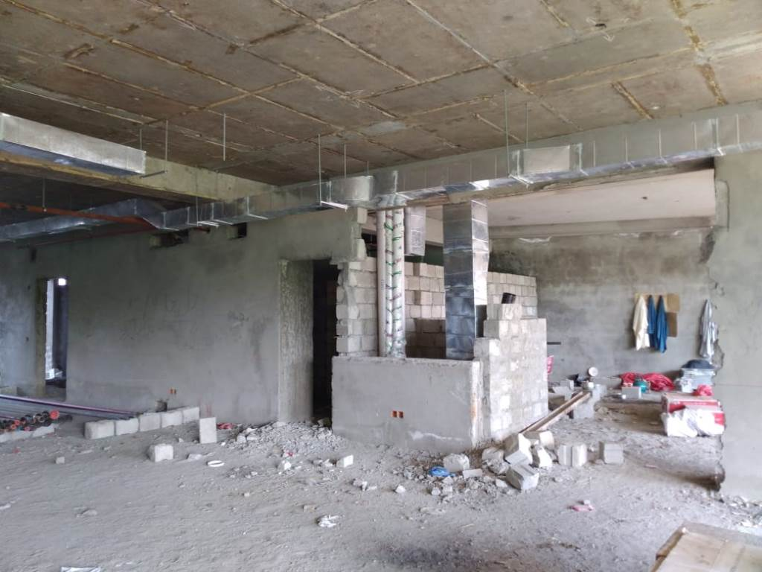
FDOC – Erection of HVAC Ducts (June 2020)

Slide 26
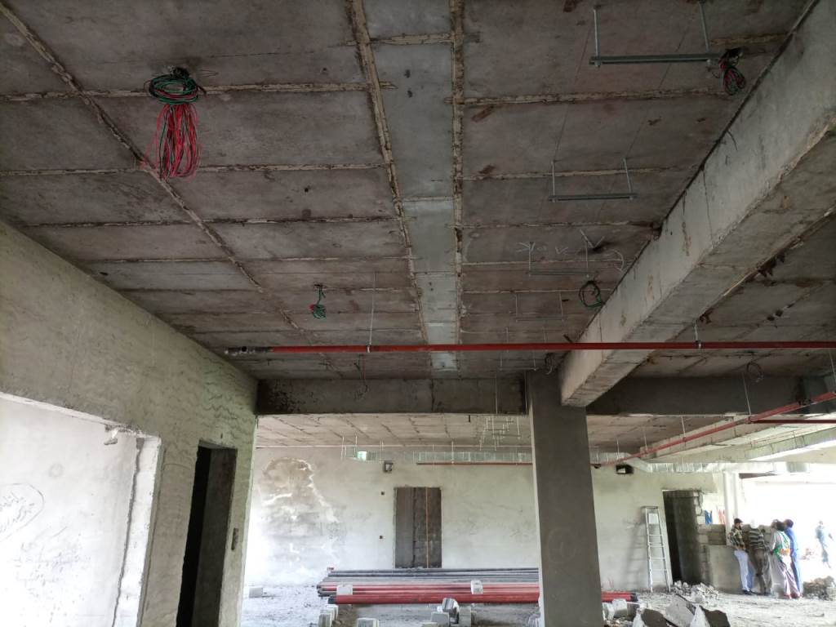
FDOC – General Wiring (June 2020)

Slide 27
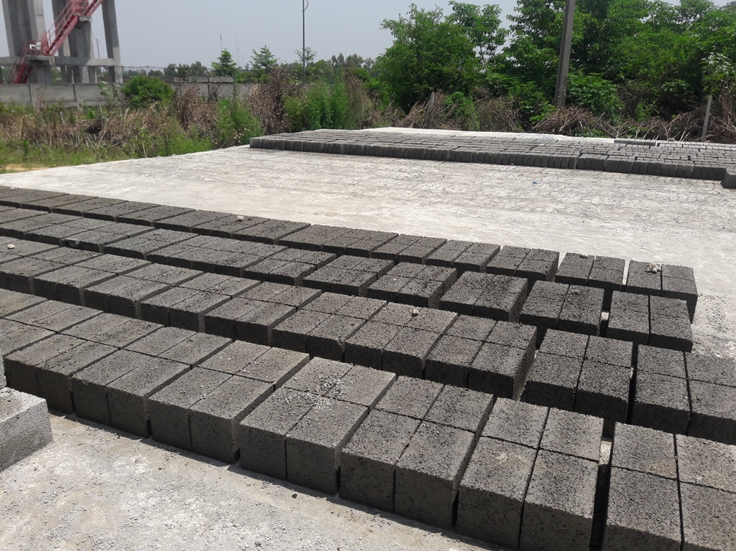
FDOC – Supply of Concrete Blocks (June 2020)

Slide 28
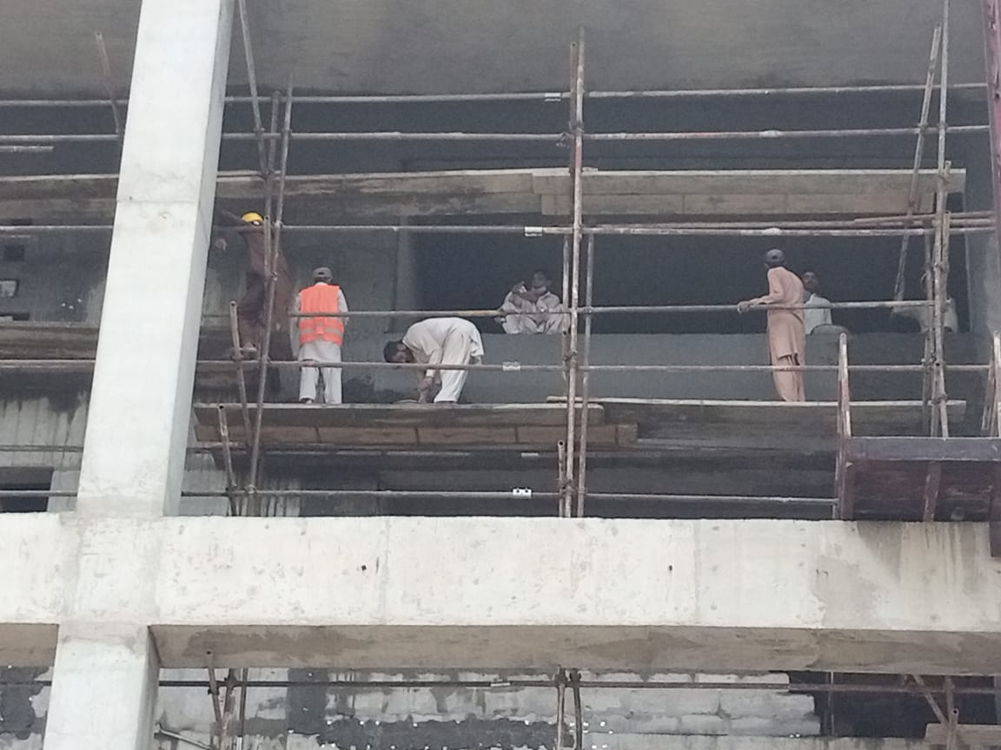
Block & Plaster Work (June 2020)

Slide 29
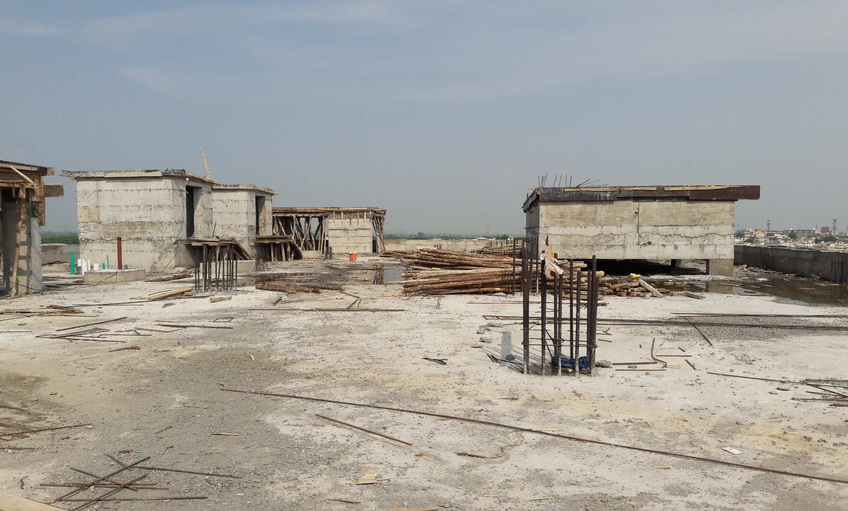
FDOC – Formwork for Mumty/OHWT/Machine Room Slab (July 2020)

Slide 30
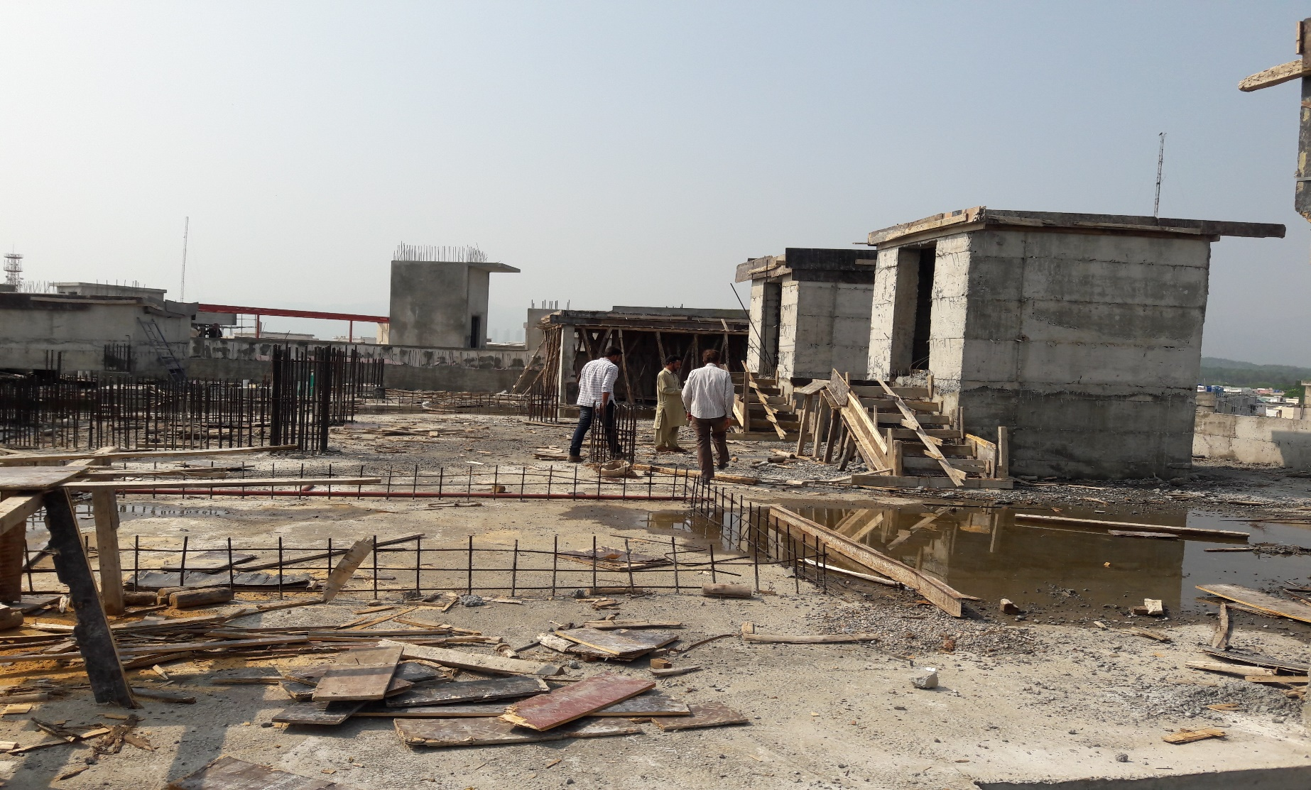
FDOC – Formwork for Mumty/OHWT/Machine Room Slab (July 2020)

Slide 31
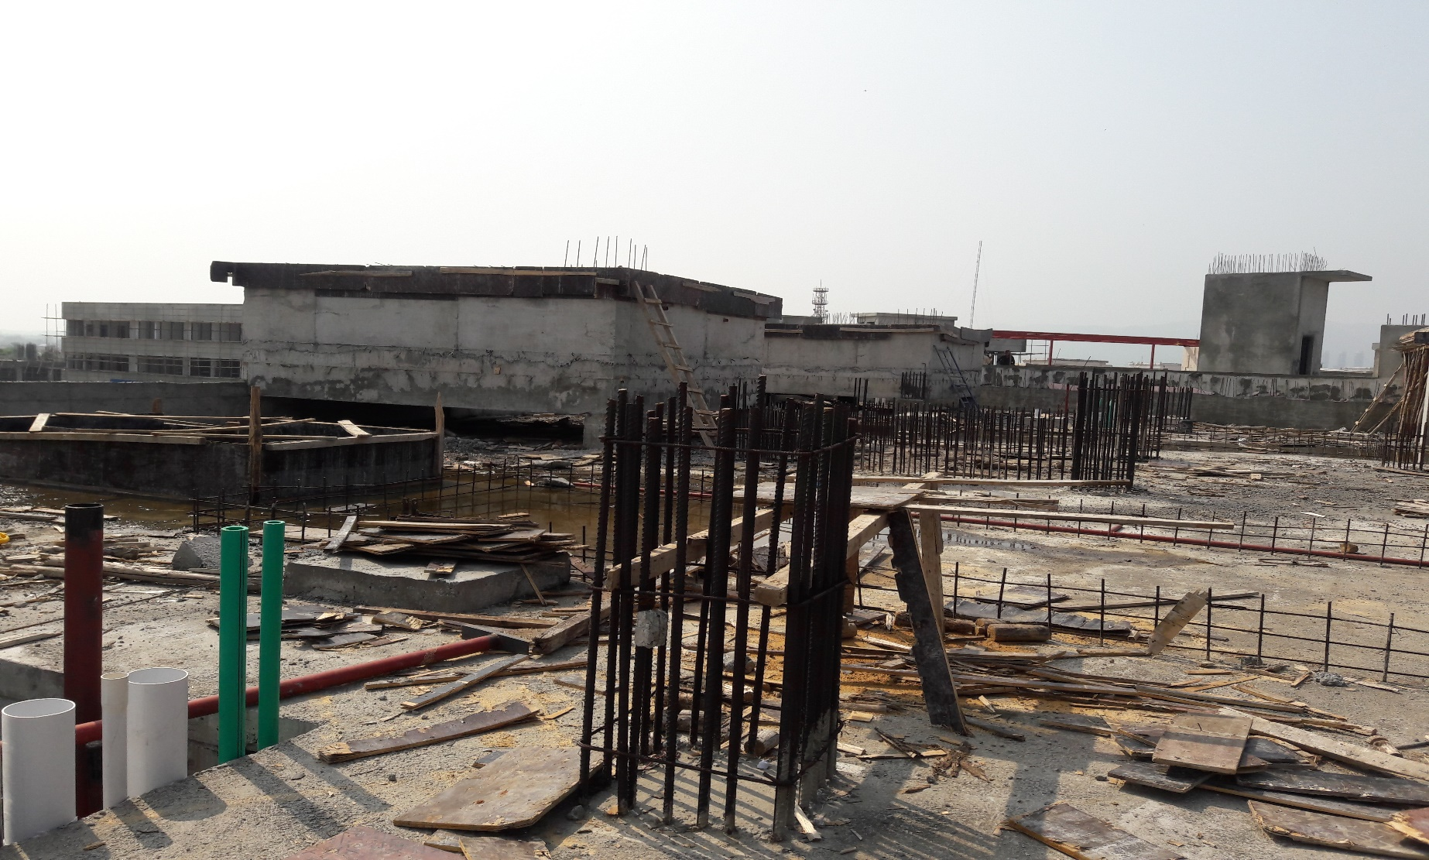
FDOC – Formwork for Mumty/OHWT/Machine Room Slab (July 2020)

Slide 32
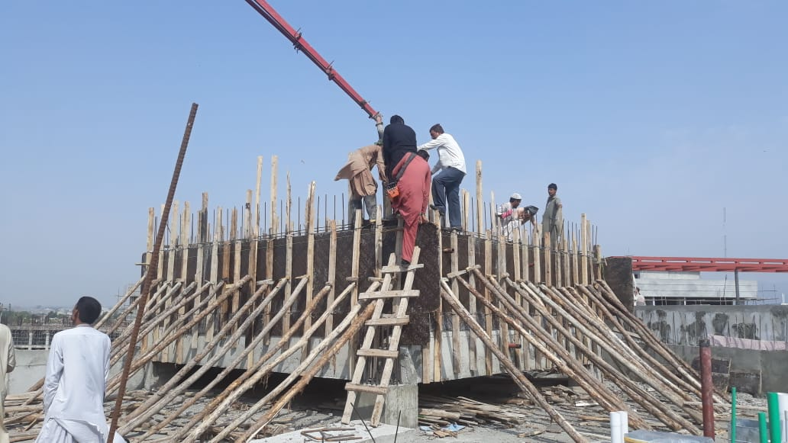
FDOC – Concrete Placement for OHWT Walls (July 2020)

Slide 33
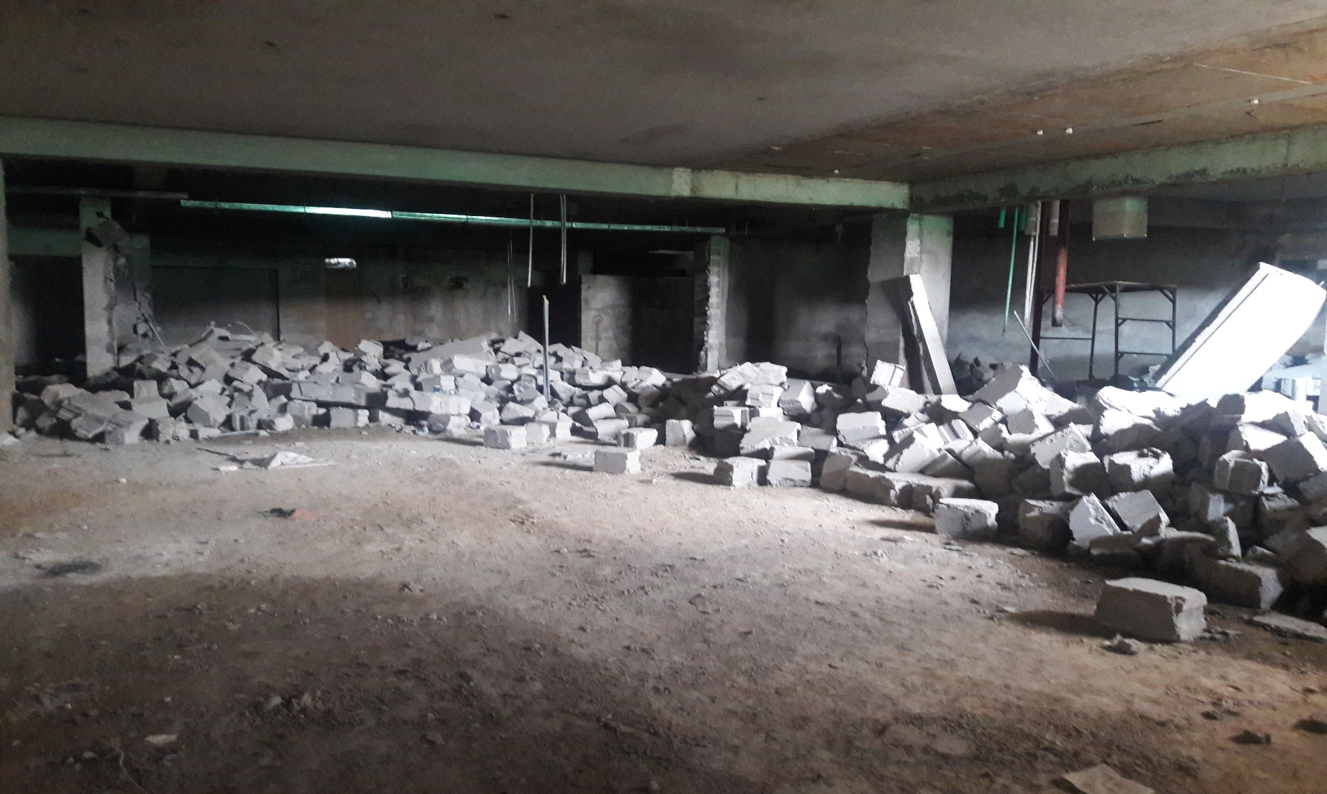
FDOC – Dismantling of Block Masonry (July 2020)

Slide 34
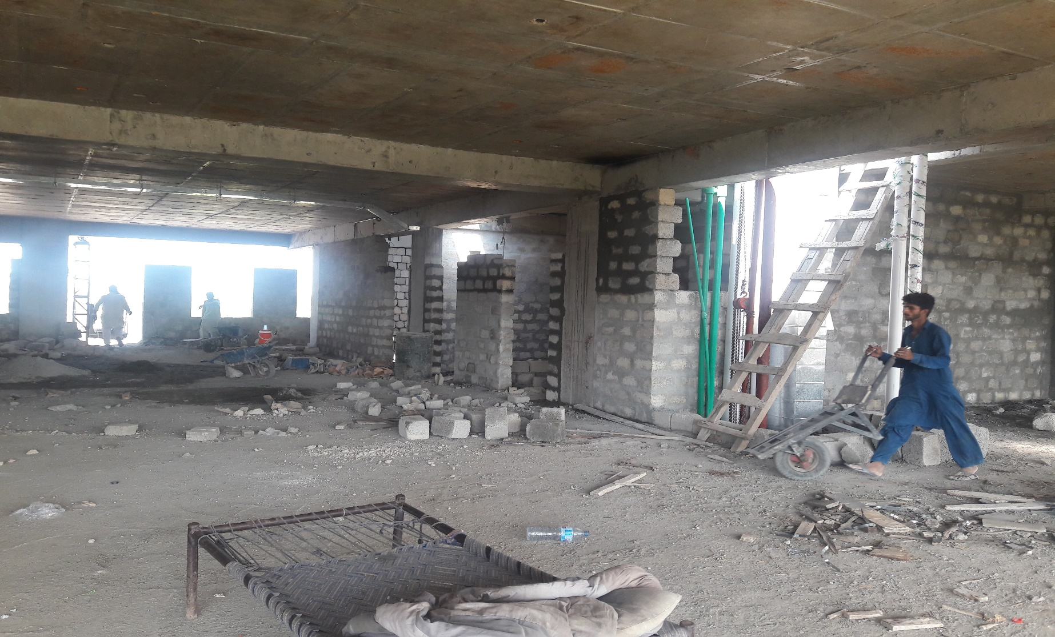
FDOC – Block Work (July 2020)

Slide 35
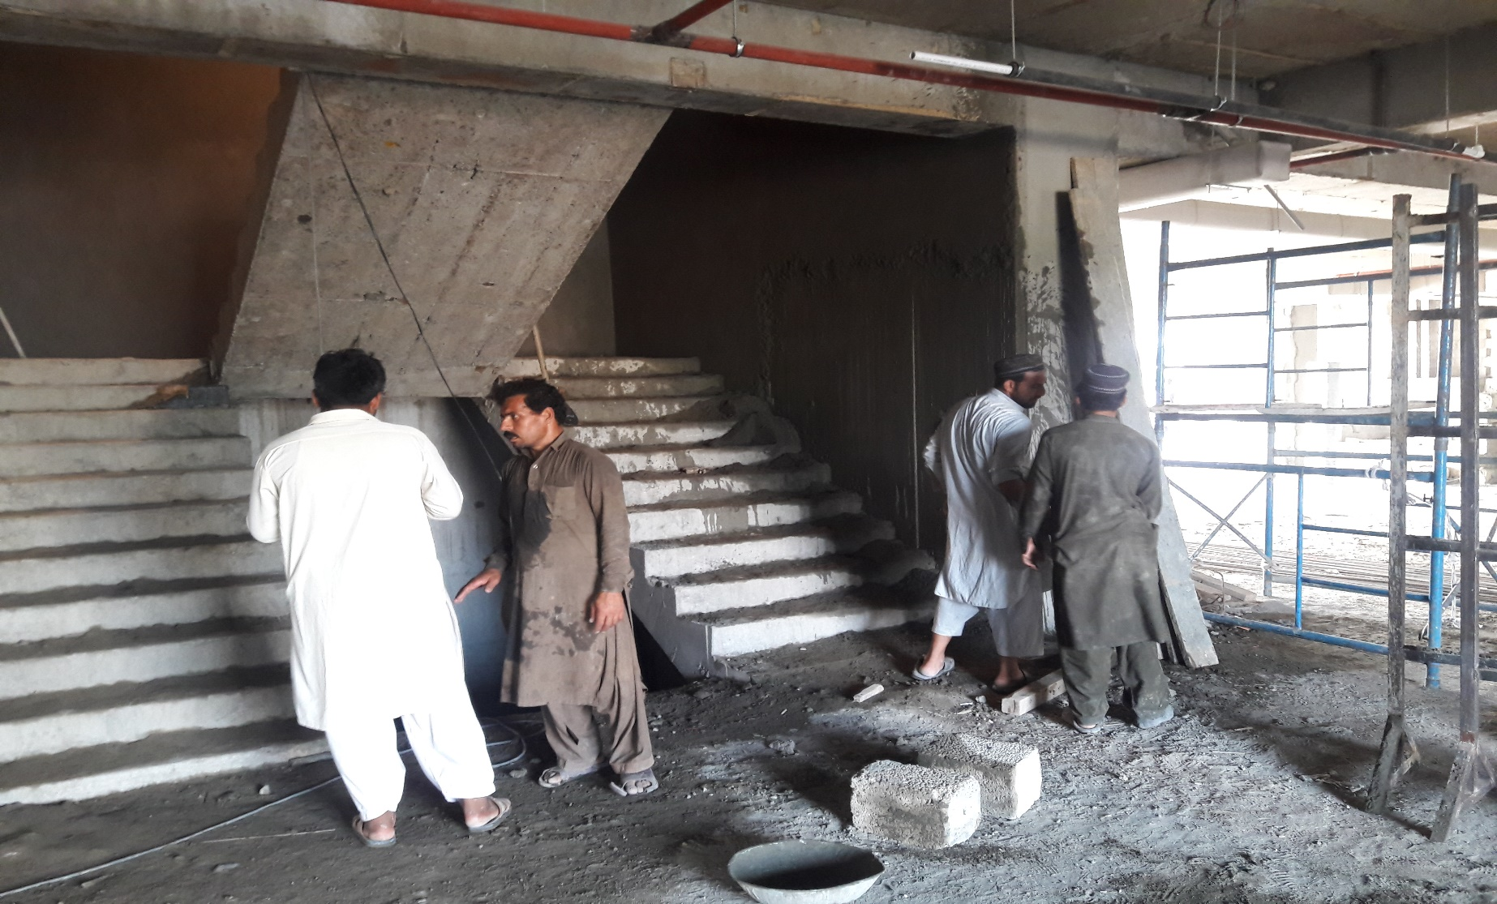
FDOC – Plaster Work (July 2020)

Slide 36
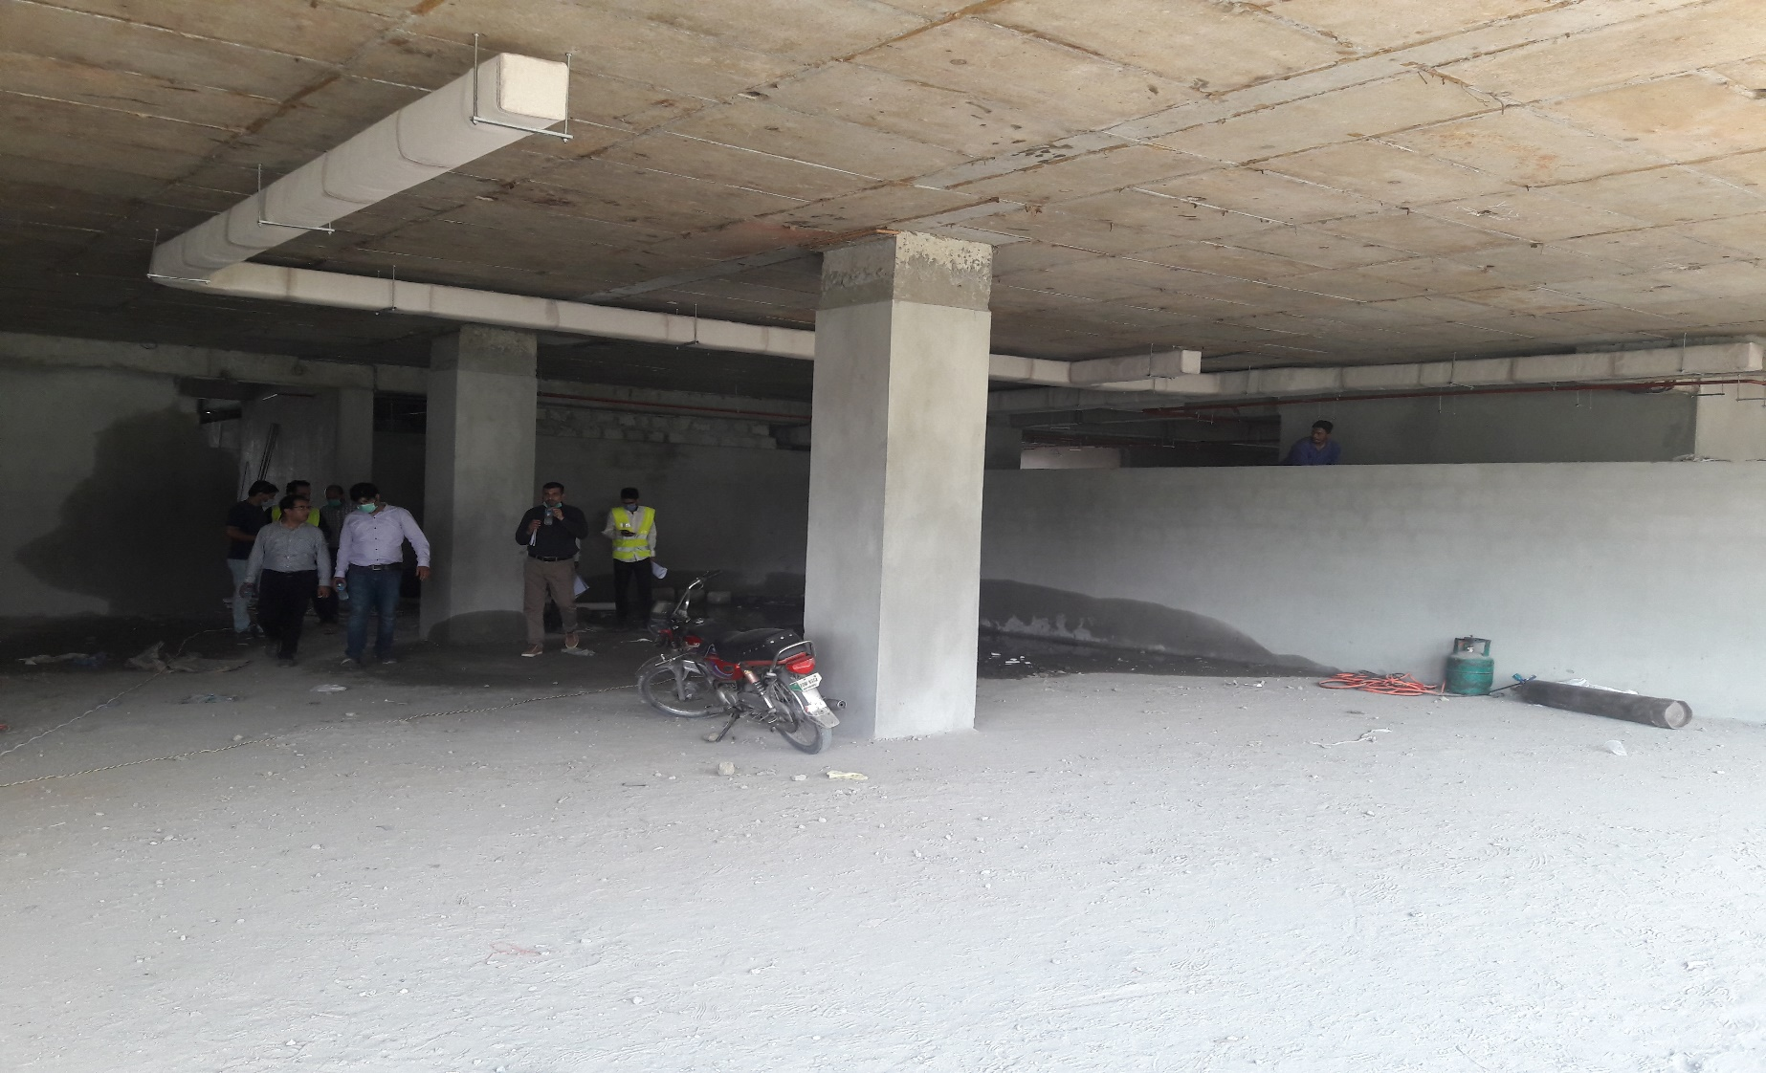
FDOC – Plaster Work (July 2020)

Slide 37
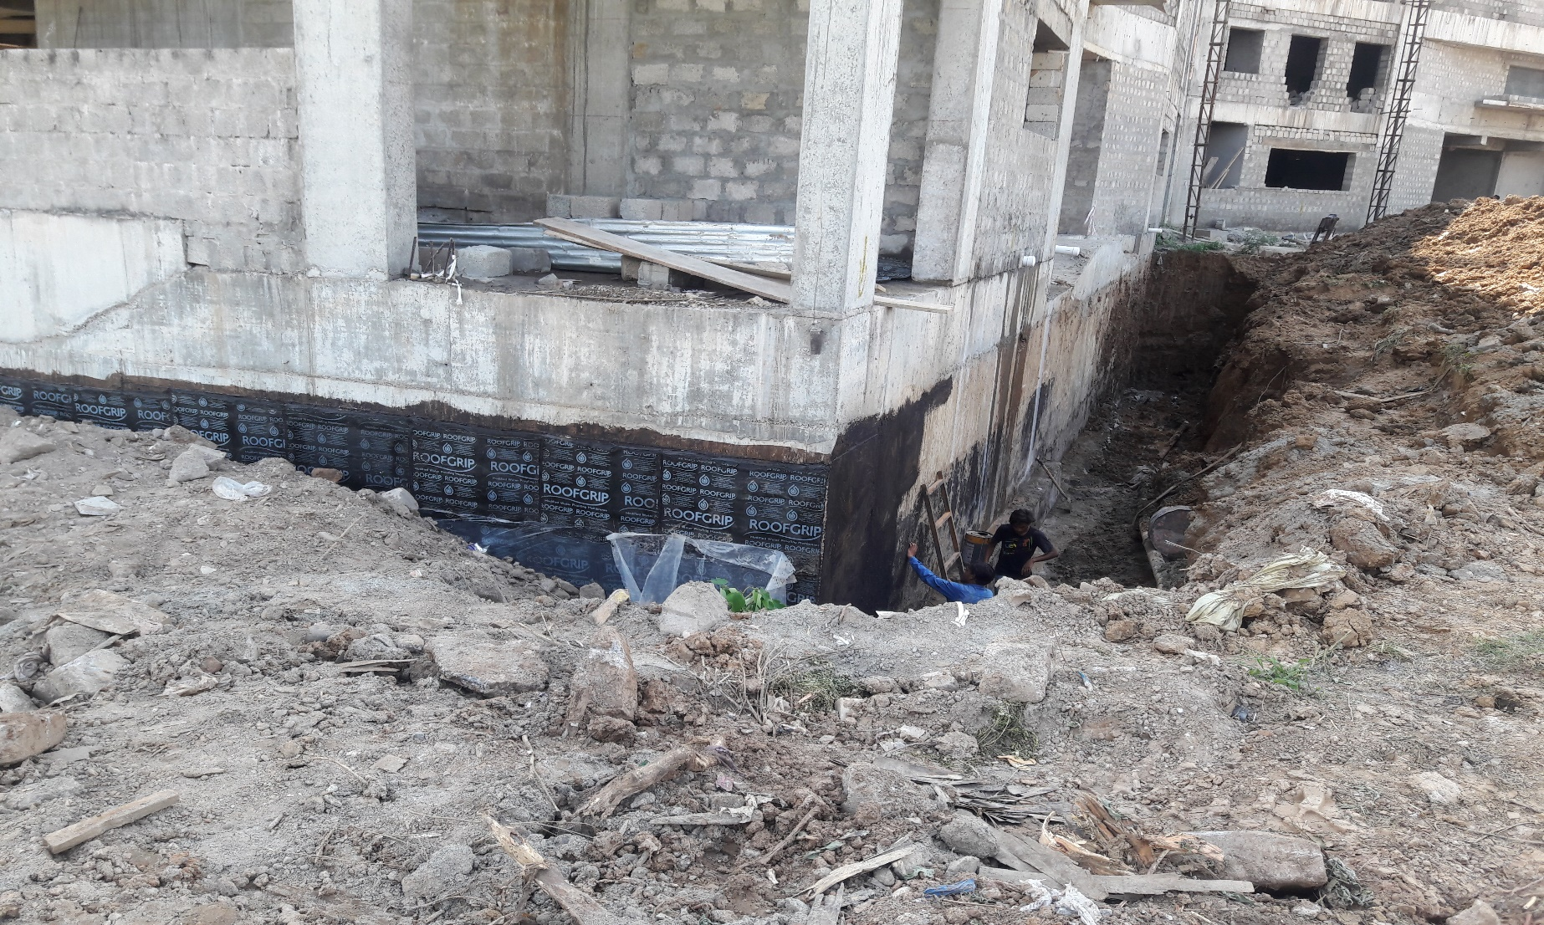
FDOC – Water Proofing (July 2020)

Slide 38
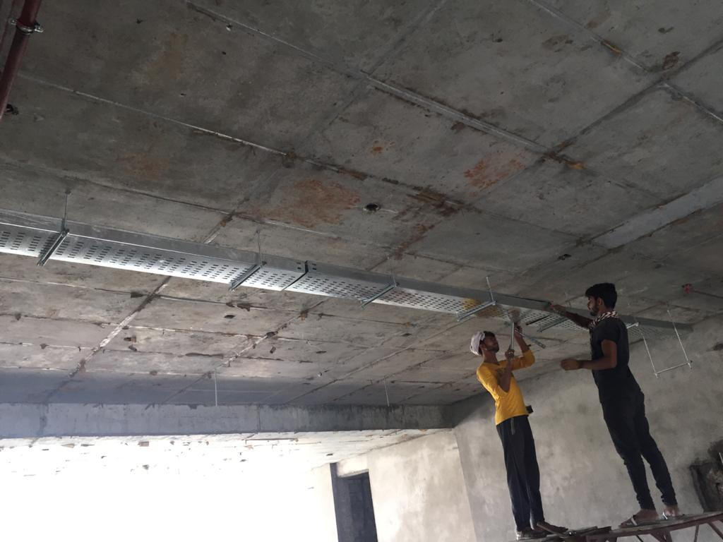
FDOC – Erection of Cable Tray (July 2020)

Slide 39
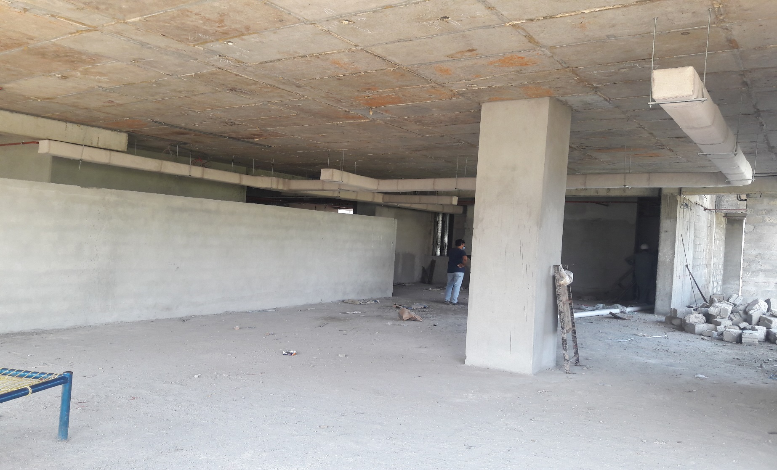
FDOC – Erection & Insulation of HVAC Ducts (July 2020)

Slide 40
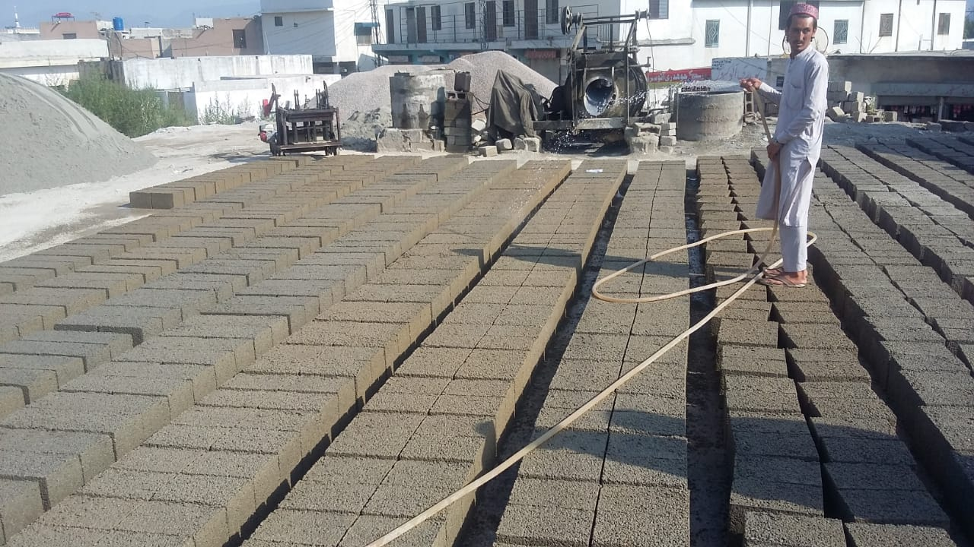
FDOC – Supply of Concrete Blocks (July 2020)

Slide 41
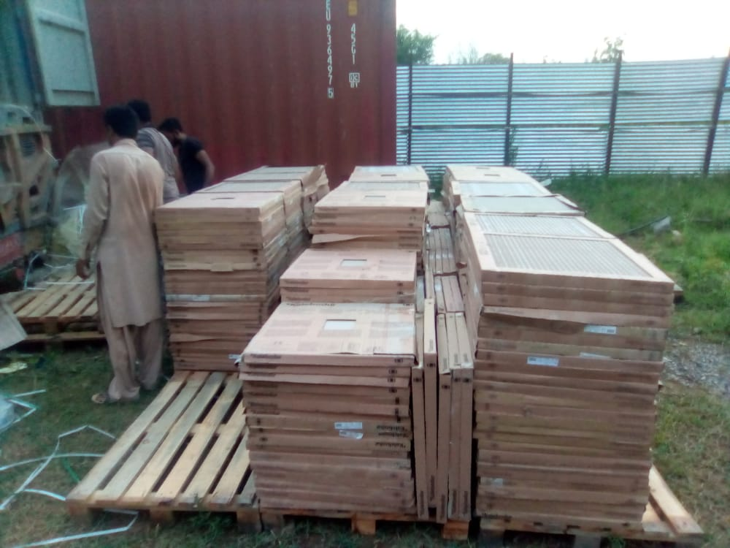
FDOC – Supply of Tiles (July 2020)

Slide 42
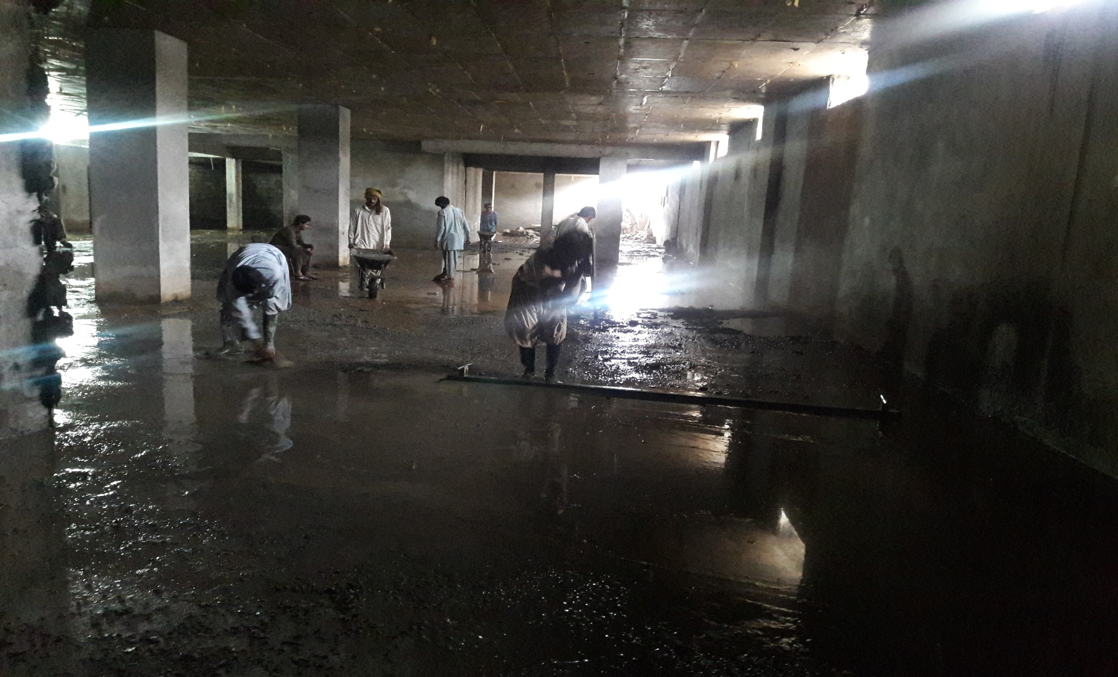
FDOC – Screeding in Basement (August 2020)

Slide 43
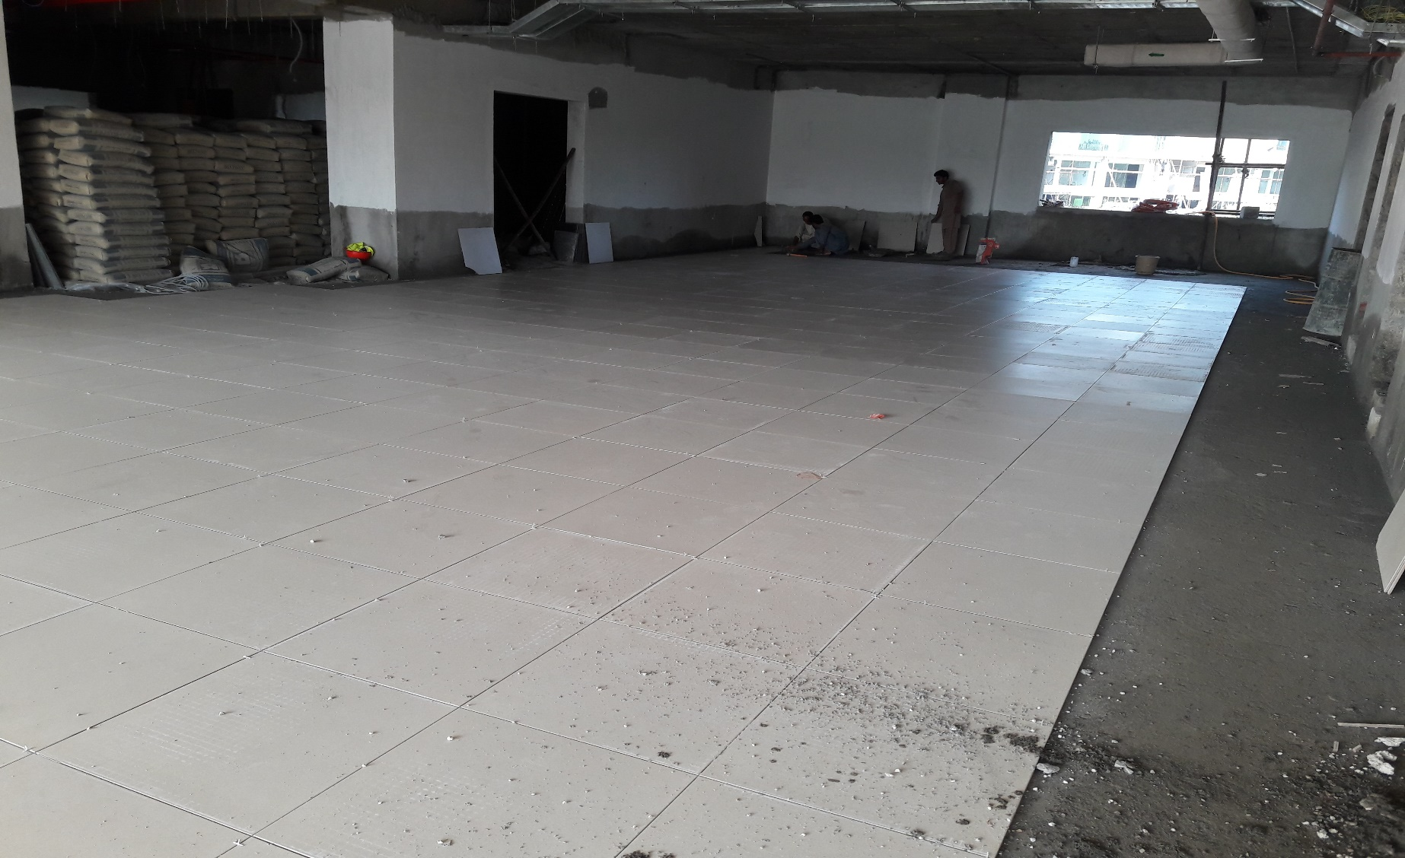
FDOC – Tile Work at Ground Floor (August 2020)

Slide 44
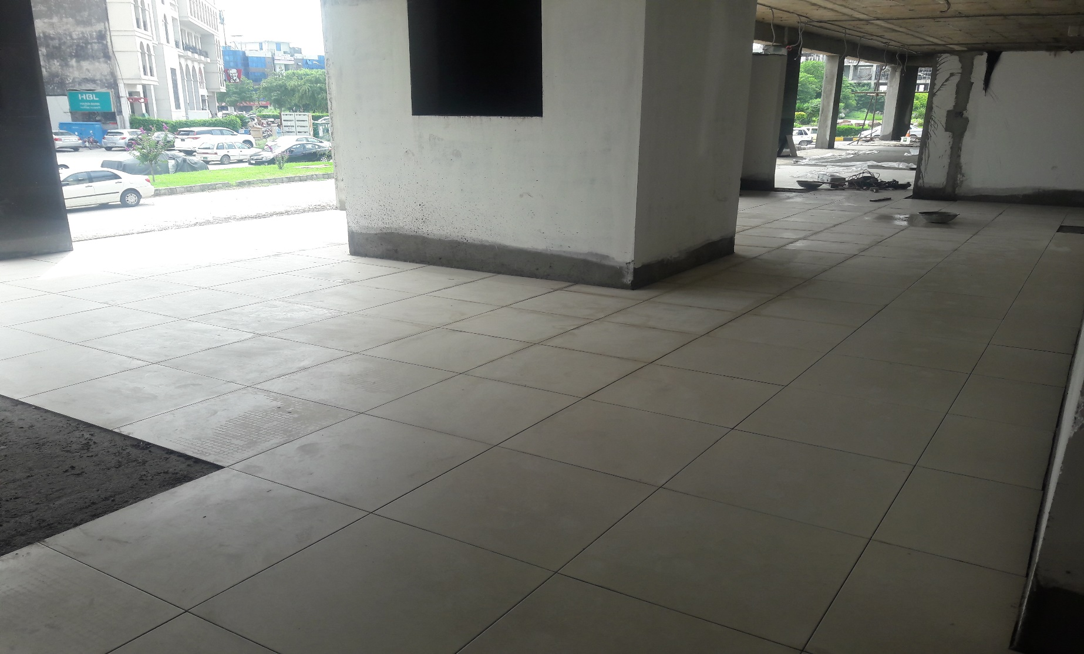
FDOC – Tile Work at Ground Floor (August 2020)

Slide 45
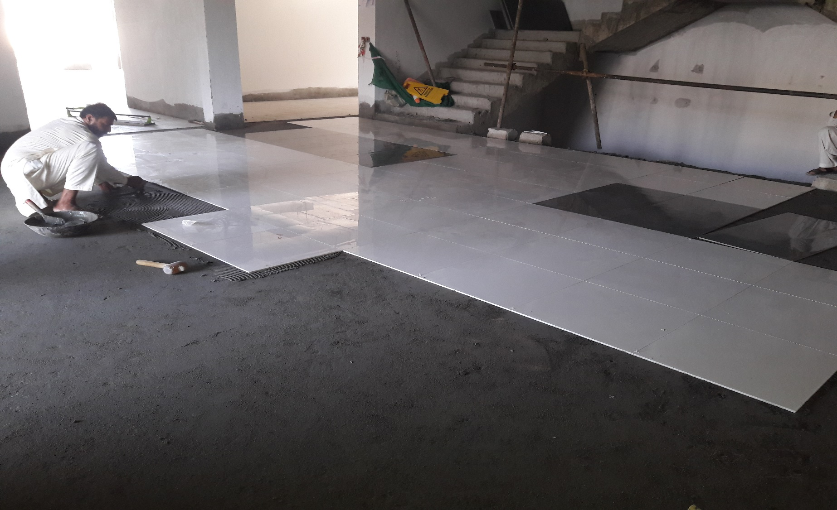
FDOC – Tile Work at Ground Floor (August 2020)

Slide 46
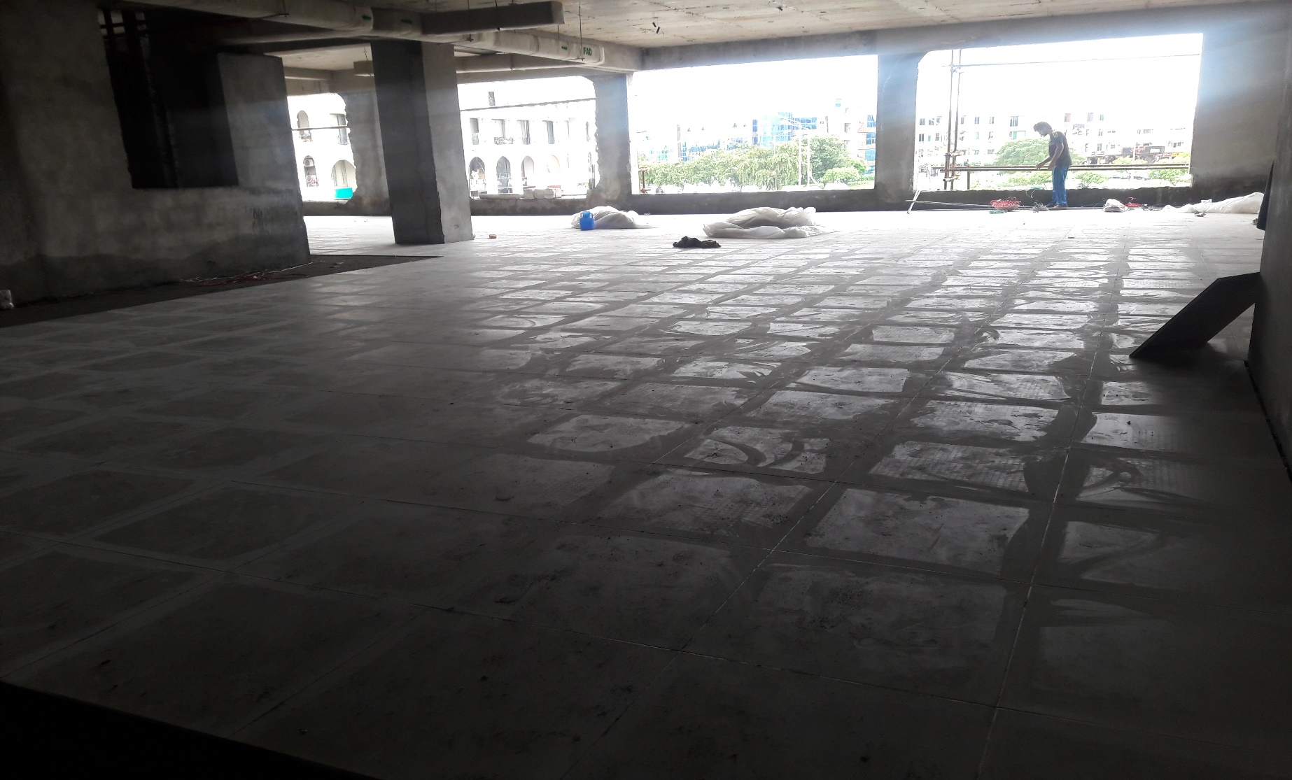
FDOC – Tile Work at First Floor (August 2020)

Slide 47
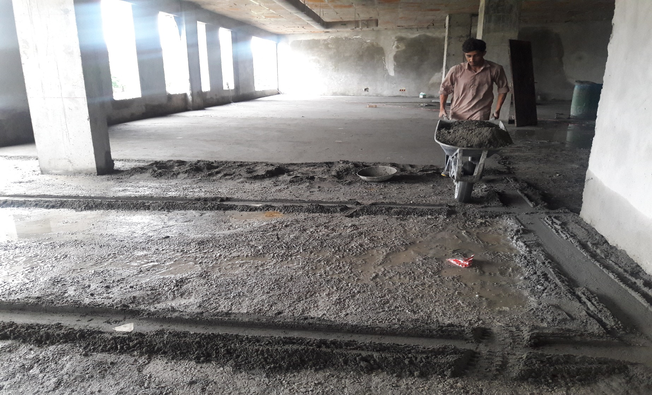
FDOC – Tile Work at First Floor (August 2020)

Slide 48
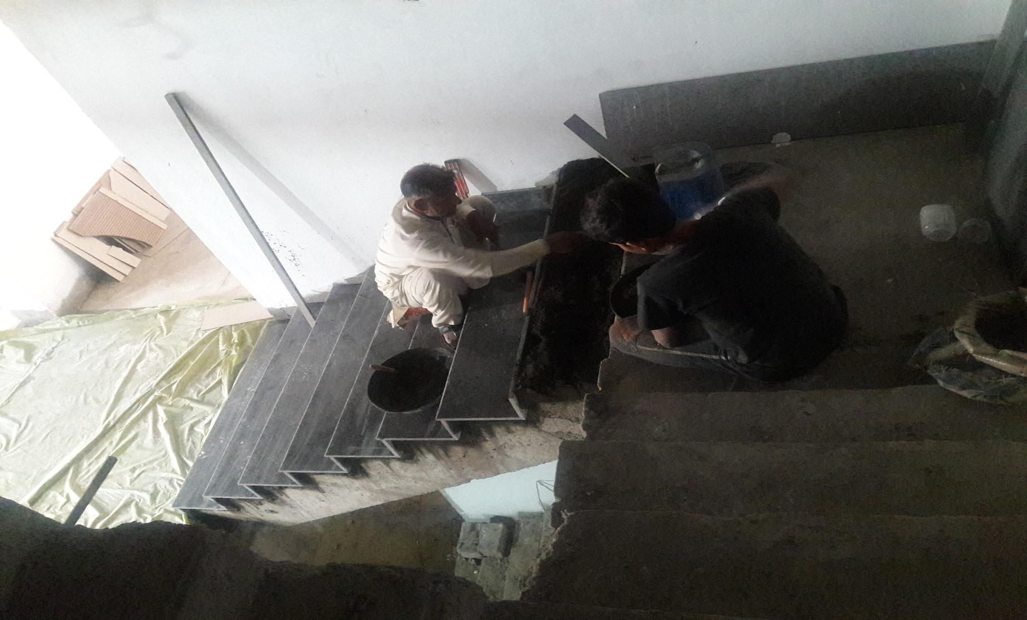
FDOC – Granite Work at Stairs (August 2020)

Slide 49
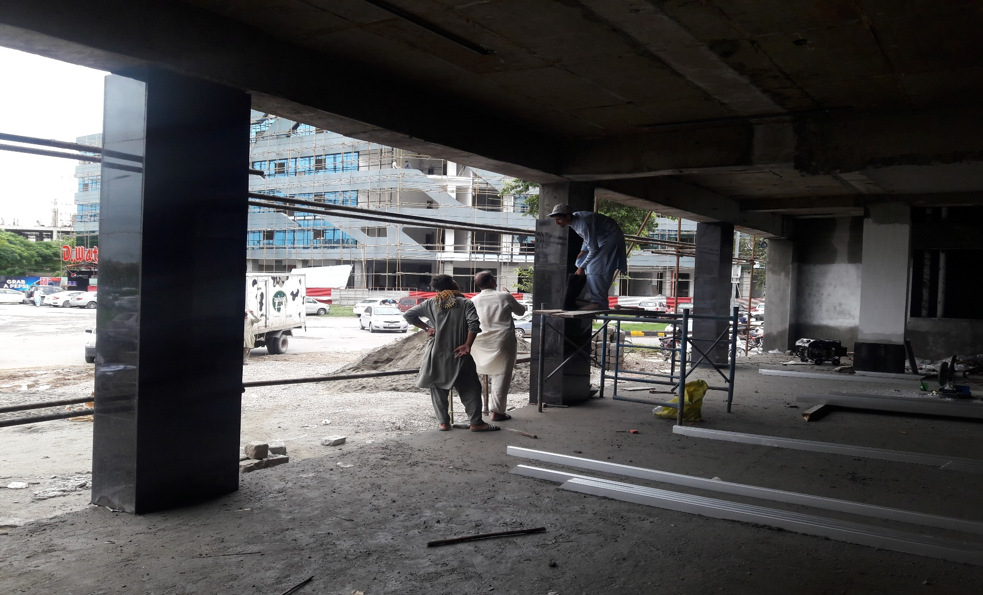
FDOC – Granite Work at Columns (August 2020)

Slide 50

FDOC – External Plaster Work (August 2020)

Slide 51

FDOC – External Plaster Work (August 2020)

Slide 52

FDOC – Façade Work (August 2020)

Slide 53

FDOC – Façade Work (August 2020)

Slide 54

FDOC – MEP Works at Roof (August 2020)

Slide 55

FDOC – MEP Works at 3rd Floor (August 2020)

Slide 56

FDOC – MEP Works at 2nd Floor (August 2020)

Slide 57

FDOC – MEP Works at 1st Floor (August 2020)

Slide 58

FDOC – MEP Works at Ground Floor (August 2020)

Slide 59

FDOC – Façade Work (Sept 2020)

Slide 60

FDOC – Façade Work (Sept 2020)

Slide 61

FDOC – External Plaster / Paint Work (Sept 2020)

Slide 62

FDOC – External Development (Sept 2020)

Slide 63

FDOC – External Development (Sept 2020)

Slide 64

FDOC – Tile Work (Basement) (Sept 2020)

Slide 65

FDOC – Tile / Granite Work (Entrance) (Sept 2020)

Slide 66

FDOC – Roof Treatment (Sept 2020)

Slide 67

FDOC – Roof Treatment (Sept 2020)

Slide 68

FDOC – Façade Work (Oct 2020)

Slide 69

FDOC – Façade Work (Oct 2020)

Slide 70

FDOC – Façade Work (Oct 2020)

Slide 71

FDOC – Façade Work (Oct 2020)

Slide 72

FDOC – External Plaster / Paint Work (Oct 2020)

Slide 73

FDOC – External Development (Oct 2020)

Slide 74

FDOC – Tile Work (3rd Floor) (Oct 2020)

Slide 75

FDOC – Tile Work (Lifts) (Oct 2020)

Slide 76

FDOC – Tile Work (Wash Rooms) (Oct 2020)

Slide 77

FDOC – Tile Work (Wash Rooms) (Oct 2020)

Slide 78
FDOC – Tile / Granite Work (Entrance) (Oct 2020)

Slide 79

FDOC – Granite Work (Oct 2020)

Slide 80

FDOC – Roof Treatment (Oct 2020)

Slide 81

FDOC – Façade Work(Nov 2020)

Slide 82

FDOC – Façade Work (Nov 2020)

Slide 83

FDOC – Internal Works (Nov 2020)

Slide 84

FDOC – Internal Works (Nov 2020)

Slide 85

FDOC – Roof Works (Nov 2020)

Slide 86

FDOC – External Plaster / Paint Work (Nov 2020)

Slide 87
FDOC – External Plaster / Paint Work (Nov 2020)

Slide 88
CCC

Slide 89

CCC-Formwork for Roof Slab in Progress (April 2020)

Slide 90

CCC-Formwork for Roof Slab in Progress (April 2020)

Slide 91

CCC-Formwork for Roof Slab in Progress (April 2020)

Slide 92

CCC-Formwork for Roof Slab (May 2020)

Slide 93

CCC – Formwork for Roof Slab (Cineplex) (July 2020)

Slide 94

CCC – Concrete Placement at Roof Slab (Cineplex) (July 2020)

Slide 95

CCC – Concrete Placement at Roof Slab (Cineplex) (July 2020)

Slide 96

CCC – Supply of Steel (July 2020)

Slide 97

CCC – Formwork for Roof Slab (Cineplex) (August 2020)

Slide 98

CCC – Formwork for Roof Slab (Cineplex) (August 2020)

Slide 99

CCC – Formwork for OHWT-01 Bottom Slab (August 2020)

Slide 100

CCC – Formwork for OHWT-02 Walls (August 2020)

Slide 101

CCC – Formwork for Roof Slab (Cineplex) (Sept 2020)

Slide 102

CCC – Concrete Placement for Roof Slab (Cineplex) (Sept 2020)

Slide 103
CCC – Formwork for Roof Slab (Cineplex) (Oct 2020)

Slide 104
CCC – Concrete Placement for Roof Slab (Cineplex) (Oct 2020)

Slide 105

CCC – Structure Works (Cineplex) (Nov 2020)

Slide 106

CCC – Structure Works (Cineplex) (Nov 2020)

Slide 107

CCC – Structure Works (Cineplex) (Nov 2020)

Slide 108

Present Progress (December 2020)

Slide 109

Present Progress (December 2020)

Slide 110

Present Progress (December 2020)

Slide 111

Present Progress (December 2020)

Slide 112

Present Progress (December 2020)

Slide 113

Present Progress (December 2020)

Slide 114

Present Progress (December 2020)

Slide 115

Present Progress (December 2020)

Slide 116

Present Progress (December 2020)

Slide 117

Present Progress (December 2020)

Slide 118

Present Progress (December 2020)

Slide 119

Present Progress (December 2020)

Slide 120

Present Progress (December 2020)

Slide 121

Present Progress (December 2020)

Slide 122

Present Progress (December 2020)

Slide 123

Present Progress (December 2020)

Slide 124
Present Progress (December 2020)

Slide 125
Present Progress (December 2020)

Slide 126
Present Progress (December 2020)

Slide 127
Present Progress (December 2020)

Slide 128
Present Progress (December 2020)

Slide 129
Present Progress (December 2020)

Slide 130
Present Progress (December 2020)

Slide 131
Present Progress (December 2020)

Slide 132
Present Progress (December 2020)

Slide 133
Present Progress (December 2020)

Slide 134
Present Progress (December 2020)

Slide 135
Present Progress (December 2020)

Slide 136
Present Progress (December 2020)

Slide 137
Present Progress (December 2020)

Slide 138
Present Progress (December 2020)

Slide 139
Present Progress (December 2020)

